Slide 1




Partisan Media and American Voters
Exposure, Impact, and Implications
Susanna Dilliplane
Deputy Director
Aspen Planning and Evaluation Program
The Aspen Institute

Slide 2




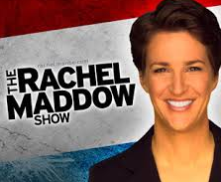

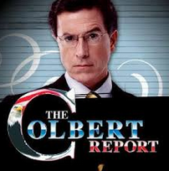










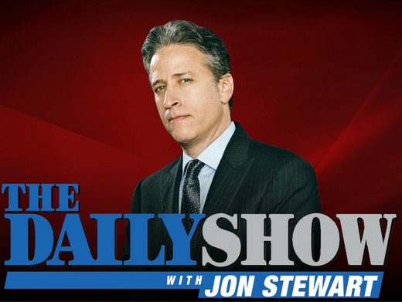




Slide 3
Why do we care?
The media’s democratic functions
Media effects
Media measurement
  Capturing diverse sources
  Capturing multi-platform exposure
  Establishing causality

Slide 4
Partisan Media
We love to hate partisan media (especially the other side’s)
We assume (fear?) that partisan media influence voters
But do they?

Slide 5
Do Partisan Media Influence Voters?
To answer, look at:
Which news sources we choose (selective exposure?)
Causal link between exposure and opinion/behavior change

Slide 6
Study Design
2008 National Annenberg Election Study Internet Panel
  Nationally representative sample (n=10,028)
5 waves over 16 months
  From pre-primary period through post-election period

Slide 7
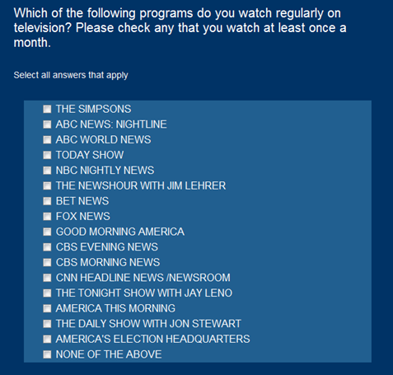
Study Design
Exposure to partisan news on TV
  45 TV programs with political content
  Coded as slanted toward Republicans, Democrats, or neutral

Slide 8
Study Design
Method of analysis: fixed effects regression
  Compares each person to him/herself at an earlier point in time; predicting change within individuals
  Stronger ability to establish causality

Slide 9
Which News Sources We Choose
Average Number of Partisan and Neutral TV News Programs Watched
Preference for likeminded over dissonant,
but neutral is most popular and most consume a mix.

Slide 10

Effects of Exposure to Partisan Media
Wait, which effects?

Slide 11
Three Key Types of Effects
Vote Choice: Does partisan news exposure influence the vote choices that citizens make?
Participation: Does partisan news exposure influence the extent to which citizens participate in politics?
Consistency: Does partisan news exposure influence the degree of internal consistency among political views?

Slide 12
Vote Choice
Vote Choice: Does partisan news exposure influence the vote choices that citizens make?
Three potential effects:
  Activation
Vote Democrat
Undecided
Vote
Republican

Slide 13
Vote Choice
Vote Choice: Does partisan news exposure influence the vote choices that citizens make?
Three potential effects:
  Activation
  Conversion
Vote Democrat
Undecided
Vote
Republican

Slide 14
Vote Choice
Vote Choice: Does partisan news exposure influence the vote choices that citizens make?
Three potential effects:
  Activation
  Conversion
  Reinforcement


 (but only a little)
Vote Democrat
Undecided
Vote
Republican

Slide 15
Three Key Types of Effects
Vote Choice: Does partisan news exposure influence the vote choices that citizens make?
Participation: Does partisan news exposure influence the extent to which citizens participate in politics?
Consistency: Does partisan news exposure influence the degree of internal consistency among political views?

Slide 16

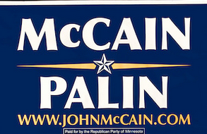


Participation
Does likeminded news mobilize voters?
  Increasing campaign activity
 Yes.

Slide 17

Participation
Does likeminded news mobilize voters?
  Increasing odds of turning out
 No.
Vote Here!

Slide 18

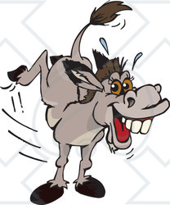
Participation
Impact of dissonant news?
  Mobilizing effect?

Slide 19

Participation
Impact of dissonant news?
  Mobilizing effect?
  Demobilizing effect?
 Yes.

Slide 20
Three Key Types of Effects
Vote Choice: Does partisan news exposure influence the vote choices that citizens make?
Participation: Does partisan news exposure influence the extent to which citizens participate in politics?
Consistency: Does partisan news exposure influence the degree of internal consistency among political views?

Slide 21
Consistency
 Yes.
Consistency among issue positions
  Joe’s issue positions become more consistent with his party’s positions over time
Republican party position
Democratic party position
Joe

Slide 22
In Summary…
Americans consume a mix of sources, including a hefty helping of neutral news
Likeminded news can influence vote choice, participation during the campaign, and consistency
So can dissonant news
Statistical vs. substantive significance
Neutral news?

Slide 23
Lessons?
The role of habit
  Turnout
  Which media sources we choose
Supply versus demand
Prompting deliberation versus inspiring participation
  Knowledge does not necessarily beget action

Slide 24
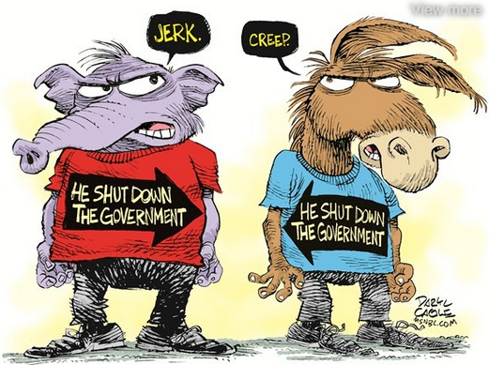
Lessons?

Slide 25
Thank you for your attention.
Questions and comments welcome!
Susanna Dilliplane
susanna.dilliplane@aspeninstitute.org
aspeninstitute.org/APEP

