Slide 1
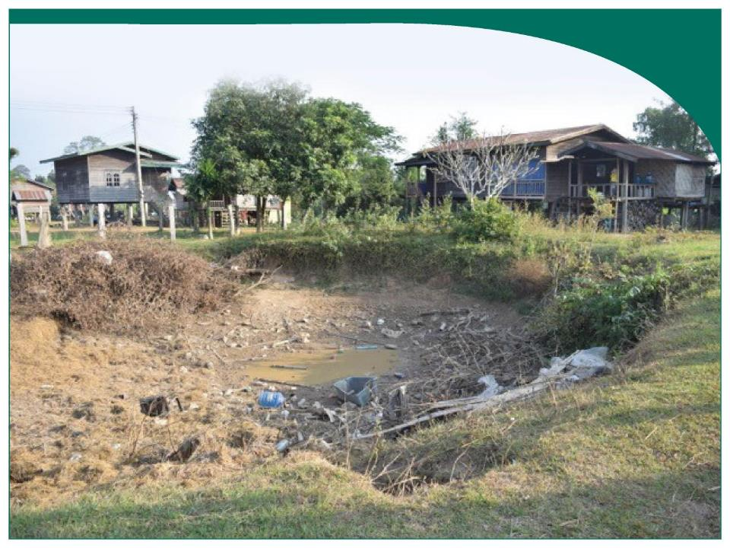
IDENTIFICATION OF POTENTIAL DIOXIN HOTSPOTS IN LAOS, WITH COMPARISONS TO VIETNAM
Susan Hammond
August 22, 2017
Dioxin 2017, Vancouver, Canada

Slide 2

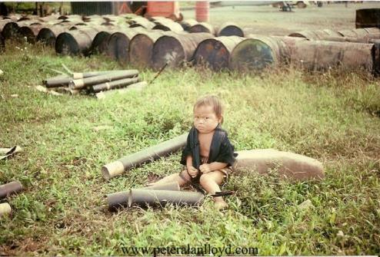
Objectives of Agent Orange work in Laos
Assess relative exposure risks at sites in Lao PDR that are potentially hazardous as a result of Agent Orange use and handling (Hatfield Consultants/MONRE/War Legacies Project)
Survey the population currently living in heavily sprayed regions or potential dioxin hotspots to determine if there is an exposure risk and health impacts (War Legacies Project /Hatfield Consultants/Green Cross International)

Slide 3
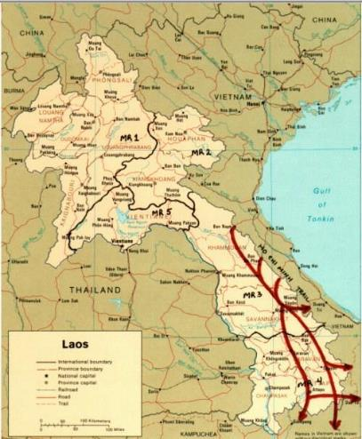
US “Secret War” in Laos
US focus during the war in Laos was to interrupt supply along the Ho Chi Minh Trail
US also supported the Royal Lao government in their fight against the Pathet Lao
The US effort in Laos was a CIA operation
Much of the CIA operation is still classified
Air Operation conducted by CIA owned airlines

Slide 4

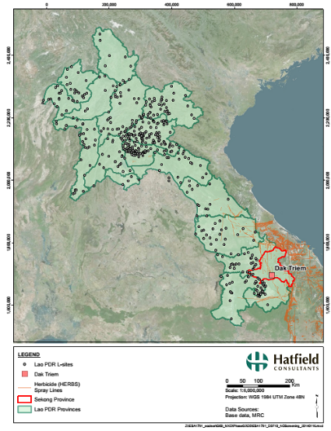
Nearly 500 “Lima” sites (L, LS and PS sites) in Lao PDR were used by the US for in-country operations
58 L Sites had runways capable of landing cargo planes and jets.
450 were LS sites for STOL (short take off and landing) or drop zones.
Trail watching/listening station were scattered along the HCM Trail
Radar sites to facilitate bombing of Vietnam and Laos were also throughout the country

Slide 5
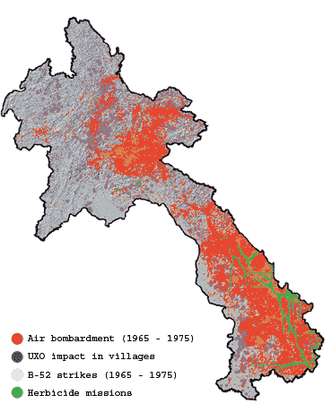
US Air Force Operations in Laos
Intensive US aerial bombing missions conducted over Lao PDR from 1963-1973
Operation Ranch Hand 1965 – 1971
Agent Orange (61% of herbicides) – used to destroy forest cover and food crops
1.6 million Liters of herbicide were sprayed over 66,000 hectares of the HCM Trail region.
Spray runs were flown from bases in Da Nang and Bien Hoa, Vietnam and from US bases in Thailand
Spraying by Air America also occurred for a limited time in the north but the extent is unknown

Slide 6
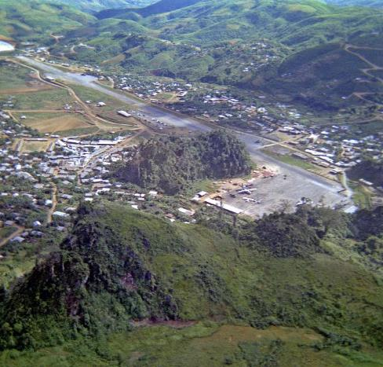
The issue today:
Elevated levels of dioxins (2,3,7,8-TCDD) are well documented in the environment in and around former US military sites in Vietnam
It is unclear how much if any perimeter spraying was conducted at US bases in Laos
It is still not known which bases controlled by the US stored herbicides
A full assessment of the potential impacts of Agent Orange in Lao PDR has not been conducted.
Long Tieng Airbase, Laos

Slide 7
Development in the GMS
Major developments:
Hydropower in Upper and Lower Mekong River: mainstream and tributaries
Mining
Forestry and plantation
Irrigation and water diversions
Infrastructure, including powerlines, roads, and railway
UXO is a major factor affecting economic development
Significant environmental and social risks for developers to manage

Slide 8
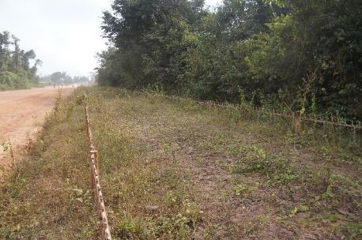
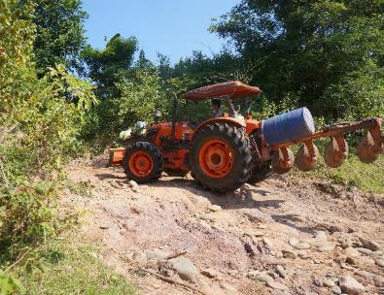
New roads are being built along the old Ho Chi Minh Trail improving access to villages for development. The roads also provide villagers access to district and provincial centers.
Ho Chi Minh Trail Today:
Previously difficult to reach regions along the sprayed and bombed regions of the Ho Chi Minh Trail are being opened up for development.

Slide 9
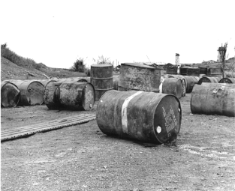
Research on Agent Orange in Lao PDR:
Limited studies on potential Agent Orange / dioxin contamination
Lacking systematic assessment of relative risks
Little knowledge among Lao government officials at national, provincial and local level of potential impacts of dioxin contamination in Laos
Increased interest in Lao PDR following mitigation in Vietnam
Sensitive issue:
Tourism
International relations
Human health

Slide 10
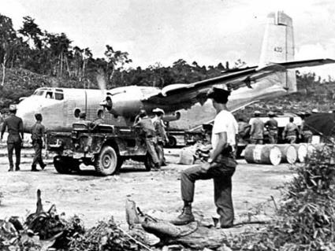
Overall Approach
Review current data and knowledge
Investigation at US National Archives
Develop systematic national screening model
Implement detailed investigation at one site
Evaluate and define next steps with end-users

Slide 11
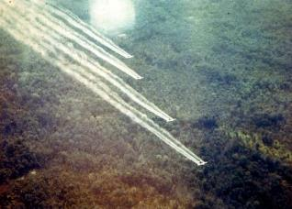
Contaminated Site Prioritization and Site Investigation
National level screening:
Develop and test a methodology to screen sites with potential dioxin contamination
Site-specific evaluation:
Develop and test EO products for integration into human health risk assessment at a demonstration site

Slide 12
Site Screening Approach
Site prioritization for detailed risk assessment
Ranking of sites based on objective metrics

Slide 13
Hazard Modelling
Screening exposure factors:
Percent human disturbed land cover within 5 km buffer
Average population density of all villages within 30 km of the hazard site;
Distance to closest village
Elevation difference between hazard site and closest village
Distance to closest road
Distance to closest foot road
Distance to closest stream
Z-score was calculated to normalize each site
Sum of Z-scores used to rank potential exposure as a measure of risk

Slide 14
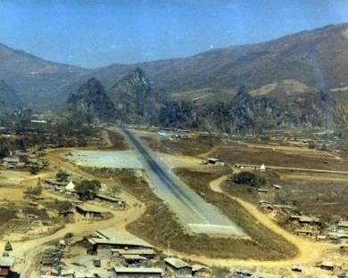
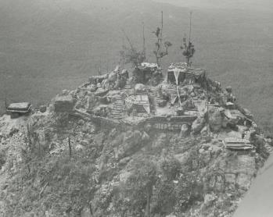
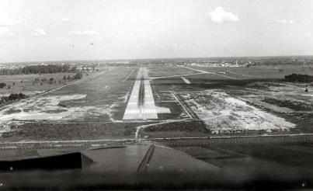
Historic “Lima” Sites
Various runway lengths and quality – “L” and “LS” sites;
Range of topographic settings
Various amount of time under US or Royal Lao government control
Range of populations in the tens of thousands (Long Tieng LS 20A to relatively unpopulated drop zones

Slide 15
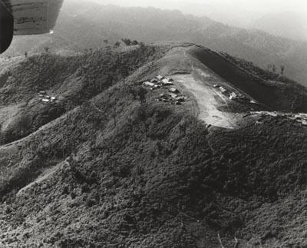
Potential hotspots
Occupied by US or Royal Lao forces between the end of 1965 and early 1971.
Heavily vegetated to warrant the use of defoliant, which would be especially likely in areas difficult to clear manually (e.g. high mountain top sites).
Bases that were of particular strategic importance, such as TACAN radar sites, military headquarters or refugee camps
Supply depots for other landing zones or bases would have a higher likelihood of being sprayed.

Slide 16
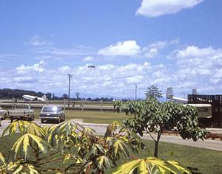
Using these criteria, the long list of in-country military sites was refined to create the short list of 27 sites for more in-depth site prioritization for risk assessment.
Rank | Site | Relative Risk |  | Rank | Site | Relative Risk
1 | Wattay/Vientiane (LS-8) | 6.65 |  | 15 | Na Khang (LS-36) | 0.08
2 | Pakse (L-11) | 5.76 |  | 16 | Long Tieng (LS-20A, LS-30, LS‑98) | -0.07
3 | Attapeu (L-10) | 4.92 |  | 17 | Thoung Leg Airfield | -0.18
4 | Luang Prabang (L-54) | 4.20 |  | 18 | Xieng Lom (LS-69) (LS-274) | -0.42
5 | Xieng Khoang North (L22) | 3.95 |  | 19 | Ban San Thong/Sam Thong (LS‑20) | -0.53
6 | Ban Huoeisay (L-25) | 3.70 |  | 20 | Pha Khao (LS-14) | -1.15
7 | Savannankhet (L-39) | 3.46 |  | 21 | Bouam Long (LS-32) | -1.16
8 | Muong Hiem (LS-48A) | 3.22 |  | 22 | Nam Lieu (LS-118A) | -1.44
9 | Muong Cha (LS-113) | 2.80 |  | 23 | Ba Na (LS-15) | -2.99
10 | Muong Soui (L108) | 2.32 |  | 24 | Ban Nam Thouei (LS-118) | -3.57
11 | The Bra (SOG Site) | 2.18 |  | 25 | The Golf Course (SOG) | -4.78
12 | Hotel 9 (SOG Site) | 2.08 |  | 26 | Leghorn (SOG Site) | -6.20
13 | Ban Son/Xon (LS-246) | 2.00 |  | 27 | Pa Doung (LS-5) | -7.16
14 | Javan (Chavan) Army base | 1.49
Air America base, Wattay Airport, Vientiane

Slide 17
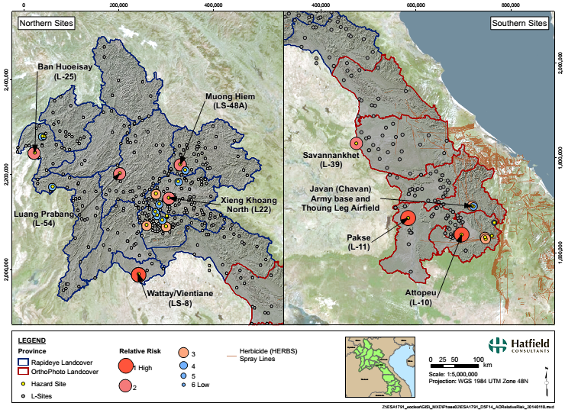
Screening and Risk Ranking Results

Slide 18
Site-specific Investigation Approach
Human health risk assessment
Problem Formulation
Effects Assessment
Exposure assessment
Risk estimation
Chemical Hazard: one or more chemical contaminants at concentrations capable of causing human health or ecological impacts;
Receptors: humans, animals or plants at the site;
Pathway: a way for chemical contaminants to reach the receptors

Slide 19
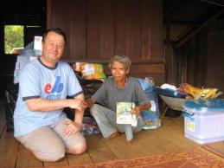
Site-specific Investigation Approach
Chemical hazard
Hatfield (2005) laboratory results indicated high TCDD levels (37.8 to 31.5 pg/g) and high percent contribution to total toxicity (TEQ-97 to 84%)
Hiyoshi (2008) laboratory results (using CALUX bio-essay) identified site as contaminated area.
Reports of Agent Orange barrels stored at this site
Receptors
EO used to define land use (buildings and aquaculture ponds) using high resolution images
Socio-economic data
Discussion with Village Head regarding site history and potential exposure pathways

Slide 20
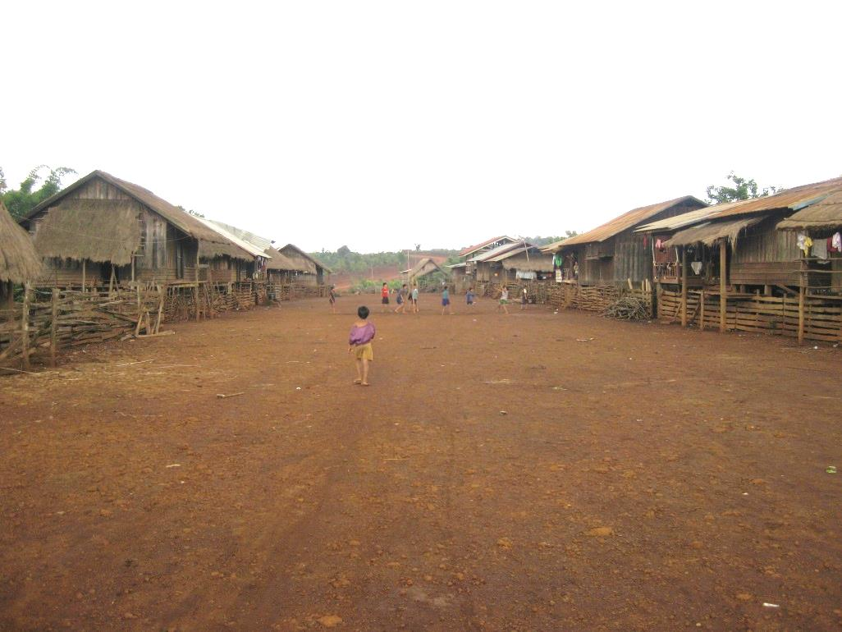
Site-specific Investigation Location
Dak Triem area incorporating the “Javan Military Site” in Dak Cheung District, Sekong Province
One of the poorest districts of Sekong Province
Village (including households and school) in close proximity to the site
Aquaculture ponds below (downstream) of the site
Bare ground and exposed soil (dust problem)

Slide 21
Preliminary Quantitative Risk Assessment
Screening level - estimates of individual variables will be approximate
Availability of high quality images and GIS analysis support the risk assessment
Hazard sources, pathways and receptors can be quickly discerned, and their proximity evaluated
Proximity of buildings, schools and other land use
Exposed soils identified from RapidEye
Water surface flow directions are calculated from topographic information

Slide 22
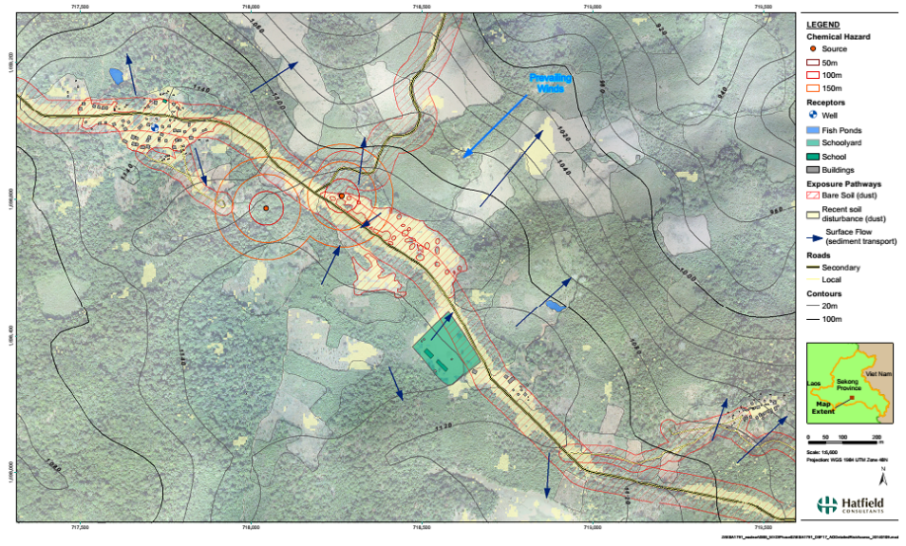
Risk Investigation Composite

Slide 23
Evaluation
National screening
Methodology can systematically remove sites unlikely to have contamination
Ranking methodology extends standard approaches
Site Screening Profiles provide a standardized snapshot of each potential hazard site
Site-specific risk assessment
Detailed maps support risk assessment and logistics and situational awareness
Improved elevation data required for drainage assessment
Hatfield also offers full contaminated site investigation, sampling and monitoring services

Slide 24
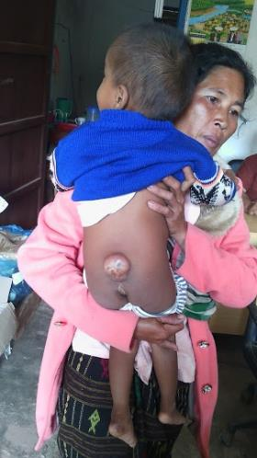
WLP’s Laos Agent Orange Laos Survey
Identify ongoing health and environmental impacts of Agent Orange Dioxin in heavily sprayed regions of Laos and potential hotspots.
Provide direct support services to those who have illnesses/disabilities that may related to exposure to Agent Orange/Dioxin or other persistent organic pollutants.
To raise worldwide awareness about the impacts of Agent Orange/Dioxin in the Lao PDR

Slide 25
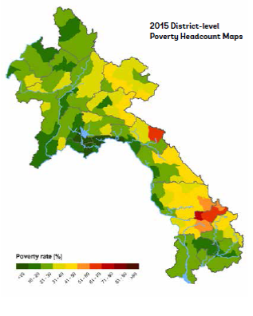
The heavily sprayed and bombed regions of southern Laos are still the poorest region in the country

Slide 26
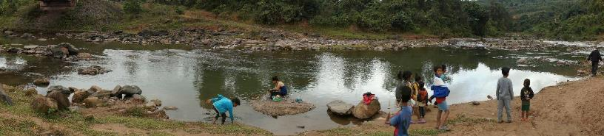
Unlike in Vietnam:
Little understanding of the use of herbicides during the war
Little understanding about potential on-going health and environmental impacts of Agent Orange/Dioxin.
No Lao government programs to address Agent Orange/Dioxin
Little data gathered on the status of health/disabilities in sprayed regions
Few studies of environmental impacts such as dioxin hotspots, soil degradation and erosion, habitat destruction or loss of valuable or culturally important trees and vegetation.

Slide 27
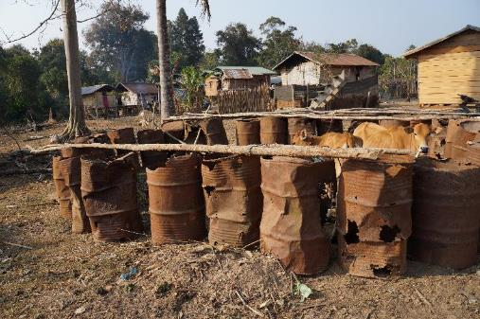
Focus Villages
Utilized HERBS spray records and the 2005 Lao DECIDE census data
200 Villages today are within 10 km of the spray routes of Khamoune, Savannakhet, Salavan, Xekong and Attepeu Provinces.

Slide 28
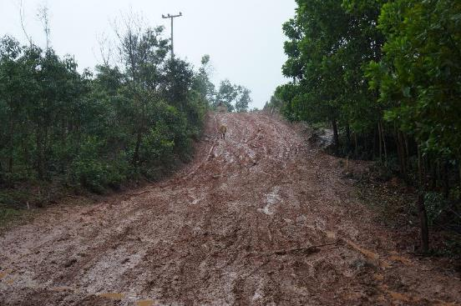
Priority Areas
Villages populated during the years of spraying or that relocated within a 10 km radius of the spraying
Villages are somewhat assessable using four-wheel drive vehicles or less than 5 km walk from an accessible road.
This left 126 villages in Samoi and Taoey in Salavan and Nong, Sepone and Villabouly in Savannakhet

Slide 29
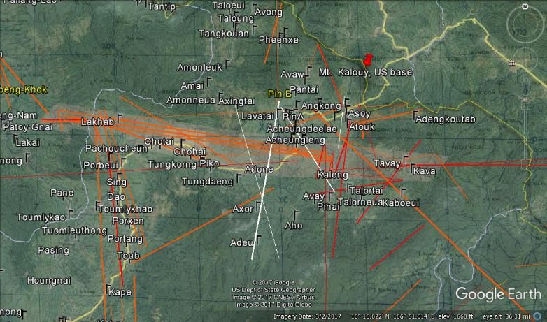
Salavan Province: Taoey and Samoi Districts

Slide 30

Interviews with elders in 36 of these villages between 2014-2017 indicate that recollection of spraying was consistent with the spray records.
Some villagers also recalled bombing and use of napalm.
Elders recollections were also consistent with the impact of the defoliants on forest cover.

Slide 31
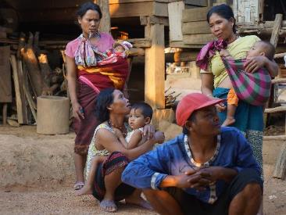
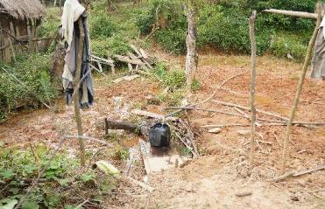
In-Depth Village Survey
Determine situation of the village before, during and after the war
Identify birth defects consistent with the VA’s lists
Interview at least 5 women of varying ages about their reproductive history.
Observe heavily defoliated mountainsides, note barrels, bomb crates and areas that might be collection points for dioxin.
Develop a list of those who will receive direct services

Slide 32
Birth Defects recognized by VA for female veterans
Achondroplasia
Cleft lip and cleft palate
Congenital heart disease
Congenital talipes equinovarus (clubfoot)
Esophageal and intestinal atresia
Hallerman-Streiff syndrome
Hip dysplasia
Hirschprung's disease
Hydrocephalus due to aqueductal stenosis
Hypospadias
Imperforate anus
Neural tube defects
Poland syndrome
Pyloric stenosis
Syndactyly (fused digits)
Tracheoesophageal fistula
Undescended testicle
Williams syndrome
Spina Bifida (only birth defect recognized for male veterans)
Bold are Conditions identified in LAOS survey

Slide 33
Survey Results:
Some patterns:
Elders report that they were more well off before the war
Malnutrition, poor health care, and non-existent pre-natal care are common to most of the villages. More remote villages are worse off.
We do not see the same severity of disabilities in Laos as we do in Vietnam.
Most birth defects found to date are in the form of limb and spinal deformities. Cleft palate/lip is also found frequently
In some cases villages that were more heavily sprayed have large numbers of people with birth defects
It is not at all possible to determine if any of the birth defects found are related to war time spraying of dioxin contaminated herbicides
Many of the heavily sprayed villages have large numbers of bomb craters that are used for fishing ponds that may require further analysis.

Slide 34


Future work
WLP will continue to survey remaining 90 villages 2017-2020
Engage the US Government regarding the need for an Agent Orange assessment in Lao PDR
Continue to get information on possible dioxin hotspots (i.e. Ranch Hand plane crash site, Long Tieng)
Continue to work to provide direct assistance to poor disabled in heavily sprayed areas

Slide 35
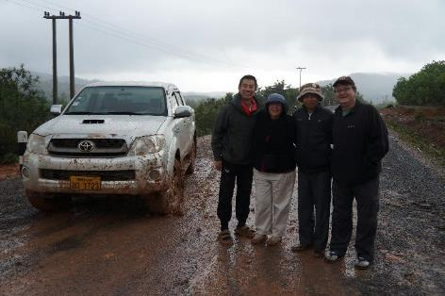
Kop Chai Lai Lai / Thank You
Susan Hammond
War Legacies Project
Chester, VT
shammond@warlegacies.org
Thomas Boivin
Boivin Enterprises Inc.
North Vancouver, Canada
tgboivin@gmail.com
Andy Dean
Hatfield Consultants Partnership
North Vancouver, Canada
adean@hatfieldgroup.com
www.hatfieldgroup.com

