Slide 1

DIOXIN CONCENTRATIONS IN FISH AND RESULTANT
HUMAN HEALTH RISK IN BIEN HOA, VIET NAM
Boivin TG, Sorenson K, Chenevey P, Moats D, Pohl HR and Durant J
Dioxin 2017 Conference, Vancouver Canada
August 22, 2017

Slide 2
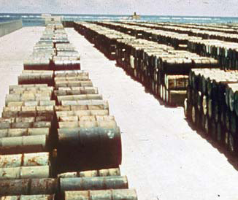
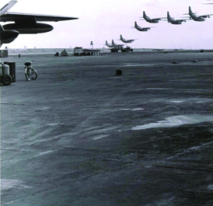
Presentation Outline
Background on Agent Orange Use in Viet Nam and at Bien Hoa Airbase
Project Objectives
Methods
Results and Discussion
Conclusions
Recommendations for Protection of Human Health

Slide 3
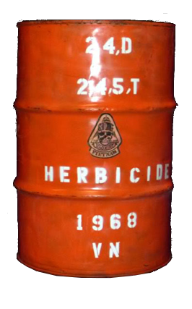
Agent Orange Use during US-Viet Nam War
Operation Ranch Hand 1961 – 1971
Over 80 million litres (>600 kg) of herbicides were released into the environment of southern Viet Nam.
~1.6 million litres (75% being Agent Orange) were also applied over
660,000 ha of Laotian territory.
Agent Orange (61% of herbicides) used to destroy forest cover and food crops.
Elevated levels of dioxins (2,3,7,8-TCDD) well documented in the environment in and around former US military sites in Viet Nam.

Slide 4
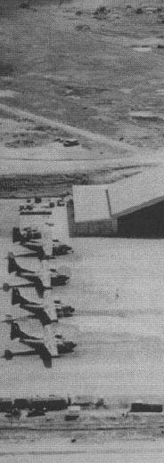
Bien Hoa Airbase
Largest Ranch Hand Site in Viet Nam:
98,000 Barrels of Agent Orange;
45,000 Barrels of Agent White;
16,000 Barrels of Agent Blue;
11,000 Barrels transferred to Johnston Island under Pacer Ivy Program in 1970;
Extensive spillage occurred in 1969/1970:
  25,000 litres of Agent Orange;
  2,500 litres of Agent White.
>1 million ppt dioxin has been recorded in soils from the area (VRTC and VEA data)
A secure landfill has been constructed by MND to contain the contaminated material.

Slide 5
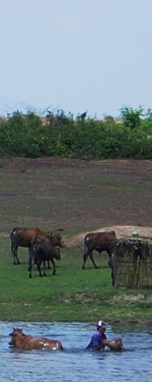
Dioxin Contamination at Bien Hoa Airbase
Significant contamination in 4 areas:
  Z1 area (main storage area);
  Southwest Area;
  Pacer Ivy area;
  Airbase Lakes (Z1 Lake & Aquaculture ponds).
People live and work on the airbase, and are harvesting fish and livestock for sale in local markets in Bien Hoa City;
Numerous ways in which dioxin can enter the human population (ingestion, dust inhalation, soil contact).

Slide 6
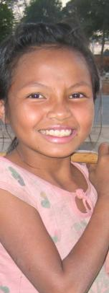
Human Exposure to Dioxins in Viet Nam
Dioxin is known to cause cancer, and a number of other human health issues.
Chemically stable and bio-accumulates in fatty tissues.
Food consumption contributes to more than 90% of the human exposure to dioxins.
Highest levels of dioxin contamination are associated with three major “hot spots” at former US military airbases in Viet Nam.
Some Vietnamese living in the vicinity of these bases have elevated levels of dioxins in their blood and breast milk.
Consumption of contaminated fish and other aquatic animals is the main exposure route.

Slide 7
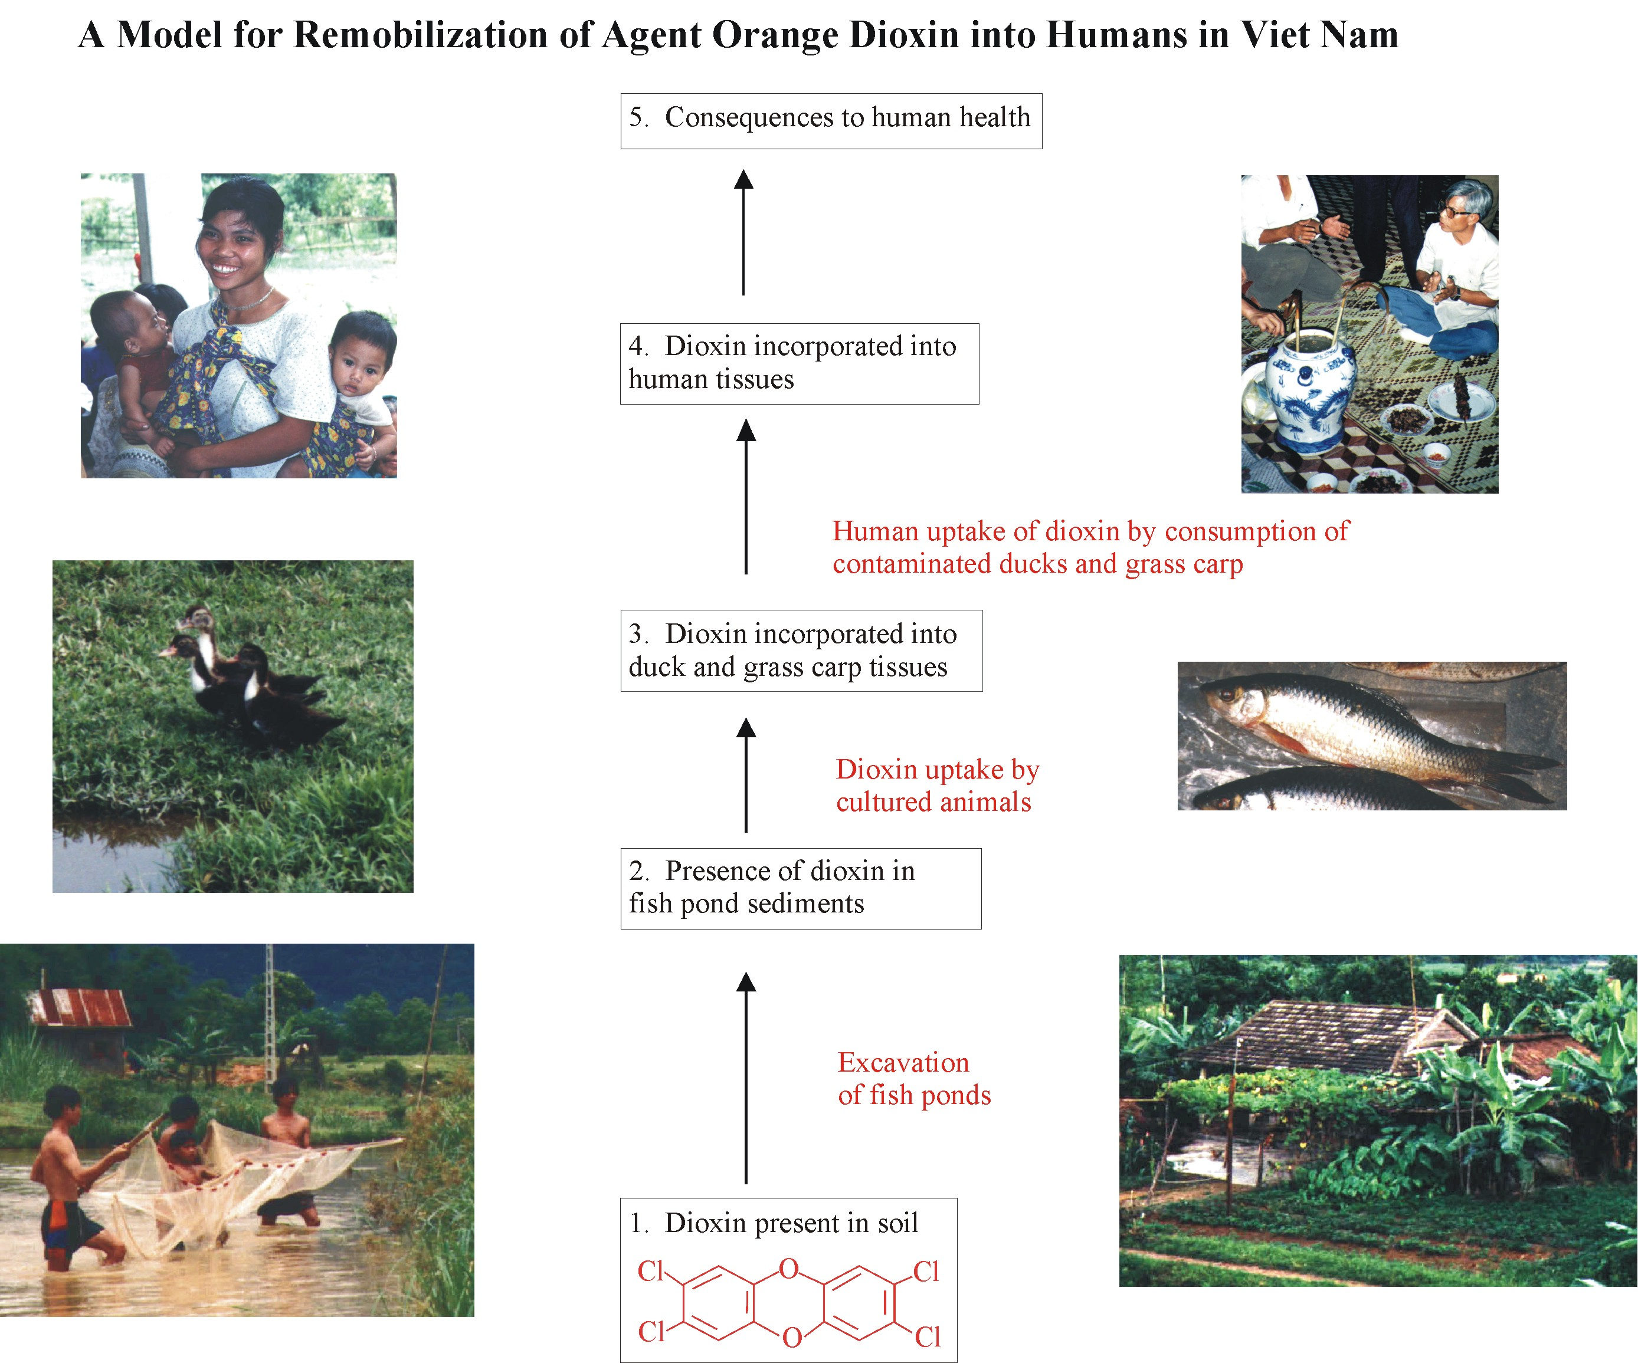
Notes:
7
Started out with 2,735 sites, then went to 133, then 28, then 18 that were targetted in recon activities.

Slide 8
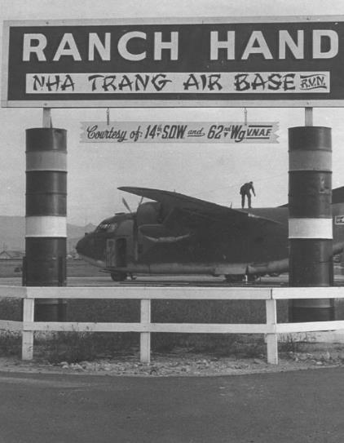
Relevant Viet Nam Dioxin Assessments
Initial research in Hue Province (1994-2000) funded by CIDA and other donors
Identification of dioxin hotspot sites at a national level (2003-2005) funded by Ford Foundation
Da Nang airbase studies and interim risk mitigation measures (2006-2009) funded by Ford Foundation
Investigations at Bien Hoa and Phu Cat airbases (2010-2011) funded by Ford Foundation and UNDP – USAID 2015-2016 survey data not included
JT Durant, TG Boivin, HR Pohl and TH Sinks. 2014. Public Health Assessment of dioxin-contaminated fish at former US Airbase, Bien Hoa, Viet Nam International Journal of Environmental Health Research, 2014 – http://dx.doi.org/10.1080/09603123.2014.938026

Slide 9
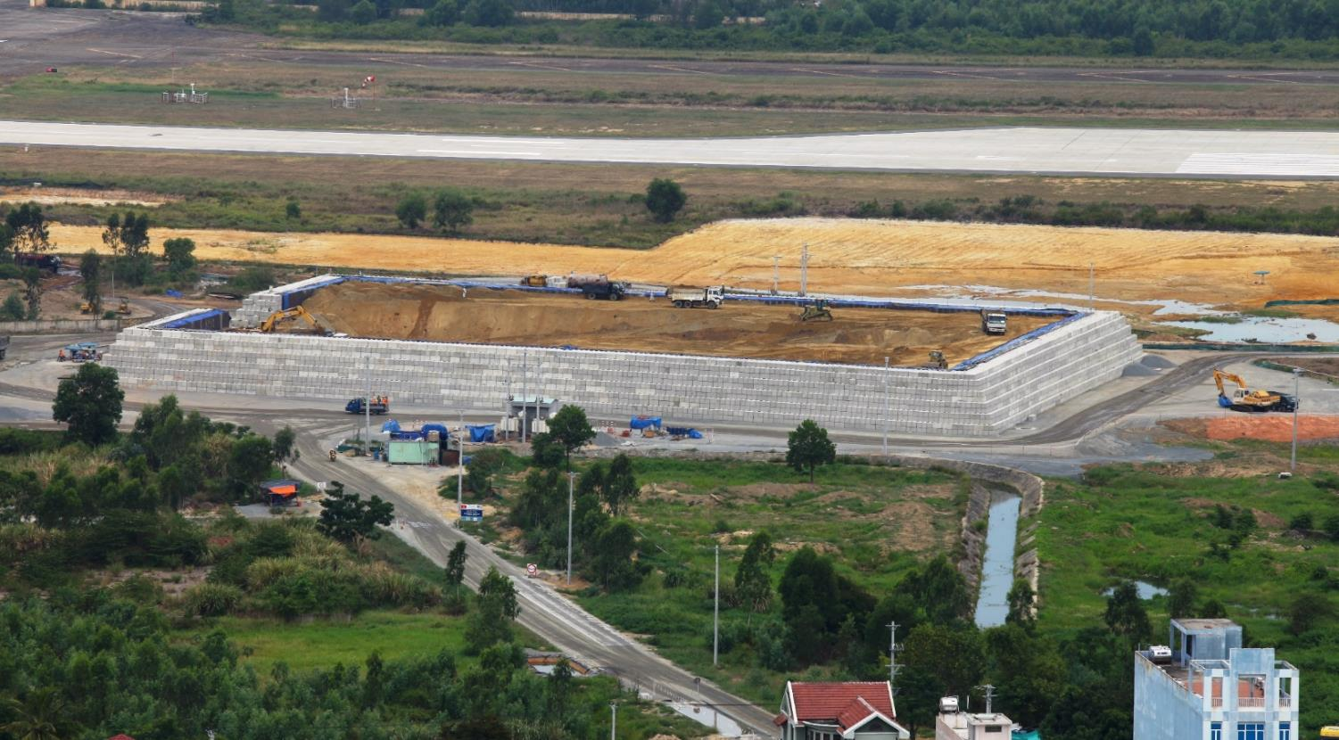

Environmental Remediation of Dioxin Hotspots
Remediation work at Da Nang Airport funded by USAID (2012-present)
Environmental Assessment conducted at Bien Hoa (2014-2016) - USAID
See: (https://www.usaid.gov/vietnam/documents/environmental-assessment-dioxin-contamination-bien-hoa-airbase)
Notes:
http://www.hatfieldgroup.com/services/contaminant-monitoring-agent-orange/progress-report/

Slide 10
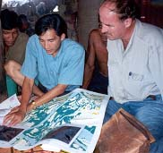

Project Objectives
Provide a comprehensive understanding of the dioxin contamination in the environment at Bien Hoa Airbase.
Assess levels of dioxins in fish, as well as soils, sediments, human blood, and breast milk.
Better understand bioaccumulation pathways in the food web and local populations.
Assist with protection of human health and development of mitigation measures for contaminated areas.
Increase public awareness and scientific knowledge exchange to help protect people from dioxin exposure.

Slide 11
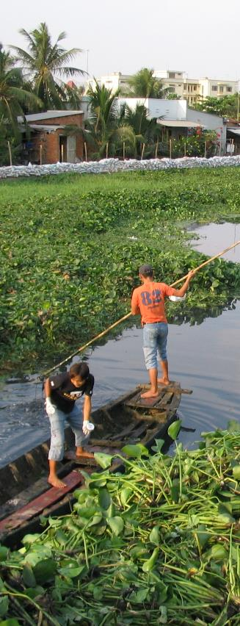
Methods
We assessed human exposure to 2,3,7,8-tetrachloro-dibenzo-dioxin (2,3,7,8-TCDD) in fish samples from aquaculture ponds on Bien Hoa Airbase.
Samples analyzed:
Fish (N=20 from 8 lakes, both on and off-base);
Other samples included soils sediments, human blood and breast milk.
All samples were analyzed at AXYS Laboratories, Canada (17 congeners used to calculate WHO-TEQ DLC concentration).

Slide 12
Methods (2)
Data assessed according to ATSDR
Public Health Assessment Guidance Manual (2005).
Mean and 95% confidence limits on TCDD concentrations calculated.
ATSDR chronic Minimum Risk Level (MRL) of 1 pg of 2,3,7,8-TCDD/kg/day used.
For cancer risk, EPA’s guidance on risk assessment for chemical contamination in fish was used (USEPA 2000).
Average per-capita fish consumption of inland fish estimated as 34.5 kg/year
(94 g/day) based on Mekong River Commission data.

Slide 13
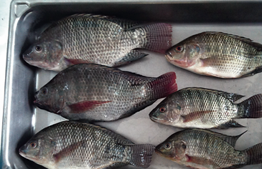
Tilapia (Oreochromis niloticus)

Slide 14
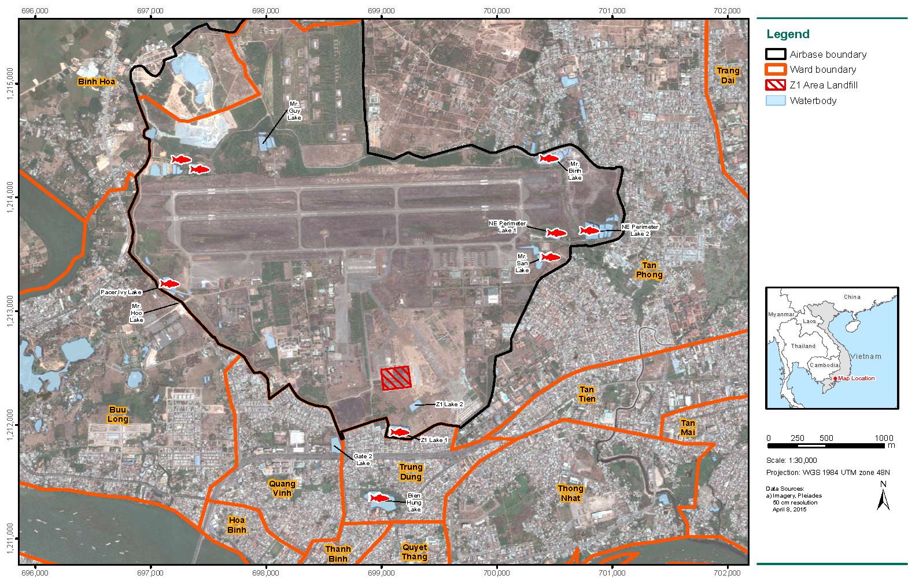
Fish Sampling Locations at the Bien Hoa Airbase, Viet Nam

Slide 15
Results and Discussion

Slide 16
Tilapia composite ﬁsh sample data, Bien Hoa
Location | Location type | Tissue type | Composite size (n) | Sample weight (g) | Mean ± SD length of ﬁsh (cm) | Mean ± SD weight of ﬁsh (g) | 2378-TCDD (pg/g) | 2005 TEQ (pg/g) | 2,3,7,8-TCDD percent TEQ
Mr San Lake | On-base | Muscle | 6 | 50 | 22.1 ± 3.3 | 254.7 | 1.4 | 1.49 | 94.0
Mr San Lake | On-base | Fat | 6 | 7 | 22.1 ± 3.3 | 254.7 | 73.3 | 76 | 96.4
NE Perimeter | On-base | Muscle | 6 | 43 | 20.4 ± 1.5 | 181.5 | 14.4 | 14.8 | 97.3
NE Perimeter | On-base | Fat | 6 | 6 | 20.4 ± 1.5 | 181.5 | 1620 | 1680 | 96.4
Mr Quy Lake | On-base | Muscle | 3 | 42 | 24.2 ± 2 | 304 | 25.4 | 25.9 | 98.1
Mr Quy Lake | On-base | Fat | 3 | 5 | 24.2 ± 2 | 304 | 2410 | 2460 | 98.0
Mr Hoc Lake | On-base | Muscle | 3 | 36 | 13.9 ± 0.9 | 59.6 | 31.2 | 31.5 | 99.0
Mr Hoc Lake | On-base | Fat | 3 | 3 | 13.9 ± 0.9 | 59.6 | 3990 | 4040 | 98.8
Pacer Ivy Lake | On-base | Whole Fish | 15 | NA | NA | NA | 618 | 622 | 99.4
Z1 Lake | On-base | Muscle | 13 | 38 | 30.3 ± 1.8 | 557 | 18.6 | 18.9 | 98.4
Z1 Lake | On-base | Fat | 13 | 41 | 30.3 ± 1.8 | 557 | 1410 | 1440 | 97.9
Z1 Lake | On-base | Whole Fish | 8 | NA | NA | NA | 94.7 | 96.5 | 98.1
Gate 2 Lake | Off-base | Muscle | 5 | 5 | 23.5 ± 2.6 | 280.3 | 32.7 | 33.2 | 95.5
Gate 2 Lake | Off-base | Fat | 5 | 237 | 9 ± 5 | 15.8 | 1490 | 1520 | 98.0
Gate 2 Market | Off-base | Muscle | 3 | 35 | 17.1 ± 5.4 | 117 | < 0.0862 | 0.0782 | NA
Gate 2 Market | Off-base | Fat | 3 | 7 | 17.1 ± 5.4 | 117 | 2.51 | 4.54 | 55.3
Bien Hoa Market | Off-base | Muscle | 2 | 52 | 32.2 ± 1.2 | 899.3 | 0.117 | 0.0856 | NA
Bien Hoa Market | Off-base | Fat | 2 | 60 | 32.2 ± 1.2 | 899.3 | 3.29 | 5.21 | 55.8
Bien Hung Lake | Off-base | Muscle | 2 | 43 | 32.3 ± 0.4 | 638 | 1.25 | 1.35 | 92.6
Bien Hung Lake | Off-base | Fat | 2 | 1 | 32.3 ± 0.4 | 638 | 86.7 | 91.8 | 94.4
Note: g, grams; cm, centimeters; n, number of ﬁsh in composite sample.

Slide 17
On-base 2,3,7,8-TCDD Concentrations in Bien Hoa Fish Tissue Samples
Table 2 On-base 2,3,7,8-TCDD concentrations ﬁsh tissue samples.
Tissue type | Location | Number of composite samples | Mean 2,3,7,8 TCDD (95% CIs), pg/g | Range 2,3,7,8 TCDD, pg/g | Median percent of TEQ comprised of 2,3,7,8-TCDD (range)
Muscle | On-base | 6 | 20.6 (8.26,33.0) | 1.4–32.7 | 97.7 (94–99)
 | Off-base | 3 | NA a,b | < 0.0862–1.250 | NA (NA–92.6 %)
Fat | On-base | 6 | 1830 (470, 3190) | 73.3–3990 | 97.96 (96.4–98.8)
 | Off-base | 3 | 30.83 | 2.51–86.7 | 55.8 (55.3–94.4)
Whole ﬁsh | On-base | 2 | NAb | 94.7–618 | 98.75 (98.1–99.4)

Slide 18
Dioxin-like compound analytical results (ng/kg), Bien Hoa Airbase
Location | Location type | Tissue type | 2378- TCDD | Total TCDD | Total PCDD | Total H6CDD | Total H7CDD | OCDD | 2378- TCDF | Total TCDF | Total PCDF | Total H6CDF | Total H7CDF | OCDF
Mr San Lake | On-base | Muscle | 1.4 | 1.4 | < 0.0499 | < 0.0499 | < 0.0499 | < 1.05 | 0.253 | 0.4 | 0.0574 | < 0.0499 | < 0.0499 | < 0.0499
Mr San Lake | On-base | Fat | 73.3 | 76.9 | < 0.494 | 3.6 | 9.59 | 40.1 | 15.7 | 24.4 | 3.49 | < 0.494 | 0.854 | 1.46
NE Perimeter | On-base | Muscle | 14.4 | 14.4 | < 0.0501 | < 0.0501 | < 0.0501 | 0.0945 | 3.41 | 3.8 | 0.0696 | < 0.0501 | < 0.0501 | < 0.0501
NE Perimeter | On-base | Fat | 1620 | 1630 | 17.2 | 3.09 | 2.63 | 3.63 | 487 | 472 | 18.3 | 0.512 | < 0.46 | < 0.46
Mr Quy Lake | On-base | Muscle | 25.4 | 25.5 | 0.187 | 0.053 | 0.105 | 0.504 | 2.53 | 3.02 | < 0.0455 | < 0.0455 | < 0.0455 | < 0.0455
Mr Quy Lake | On-base | Fat | 2410 | 2410 | 27.7 | 10.7 | 15.4 | 25.4 | 306 | 310 | 21.5 | 1.25 | < 0.497 | 0.776
Mr Hoc Lake | On-base | Muscle | 31.2 | 31.2 | 0.072 | < 0.0485 | < 0.0485 | 0.0886 | 2.21 | 2.85 | 0.0517 | 0.0485 | 0.0564 | 0.0485
Mr Hoc Lake | On-base | Fat | 3990 | 4000 | 14.4 | 7.74 | 3.65 | 8.48 | 339 | 334 | 10.7 | < 0.461 | < 0.461 | < 0.461
Pacer Ivy Lake | On-base | Whole ﬁsh | 618 | 618 | 4.07 | 6.92 | 5.14 | 8.69 | 2.81 | 4.54 | 0.323 | 0.1 | 0.285 | 0.333
Z1 Lake | On-base | Muscle | 18.6 | 18.6 | 0.123 | 0.0487 | 0.069 | 0.0852 | 1.65 | 1.91 | < 0.0487 | < 0.0487 | < 0.0487 | < 0.0487
Z1 Lake | On-base | Fat | 1410 | 1420 | 16.4 | 3.93 | 3.19 | 10.4 | 158 | 183 | 17 | 1.03 | < 0.494 | < 0.0494
Z1 Lake | On-base | Whole ﬁsh | 94.7 | 95.8 | 2.08 | 3.52 | 11.6 | 57.9 | 7.64 | 11.7 | 4.06 | 1.5 | 1.82 | 1.96
Gate 2 Lake | Off-base | Muscle | 32.7 | 32.7 | 0.233 | 0.081 | 0.08 | 0.226 | 2.76 | 3.75 | 0.129 | < 0.0496 | < 0.0496 | < 0.0496
Gate 2 Lake | Off-base | Fat | 1490 | 1490 | 13.8 | 5.82 | 3.56 | 3.73 | 162 | 189 | 5.69 | 0.807 | < 0.393 | < 0.393
Gate 2 Market | Off-base | Muscle | < 0.0862 | < 0.0499 | < 0.0499 | < 0.0499 | 0.059 | 0.123 | < 0.053 | 0.066 | < 0.0499 | < 0.0499 | < 0.0499 | < 0.0499
Gate 2 Market | Off-base | Fat | 2.51 | 4.66 | 1.17 | 1.56 | 1.93 | 2.69 | 2.01 | 6.95 | 1.78 | < 0.492 | < 0.492 | < 0.492
Bien Hoa Market | Off-base | Muscle | 0.117 | 0.05 | < 0.05 | 0.05 | < 0.05 | 0.0899 | 0.065 | 0.114 | < 0.05 | < 0.05 | < 0.0525 | < 0.05
Bien Hoa Market | Off-base | Fat | 3.29 | 5.49 | 1.55 | 1.57 | 1.5 | 3.55 | 2.85 | 5.75 | 4.64 | < 0.481 | < 0.481 | < 0.481
Bien Hung Lake | Off-base | Muscle | 1.25 | 1.25 | < 0.05 | < 0.05 | < 0.05 | 0.0622 | 0.526 | 0.603 | < 0.05 | < 0.05 | < 0.0596 | < 0.05
Bien Hung Lake | Off-base | Fat | 86.7 | 86.7 | < 0.468 | < 0.468 | 2.32 | 39.2 | 44.8 | 53.6 | 1.44 | < 0.468 | 1.07 | 1.13

Slide 19
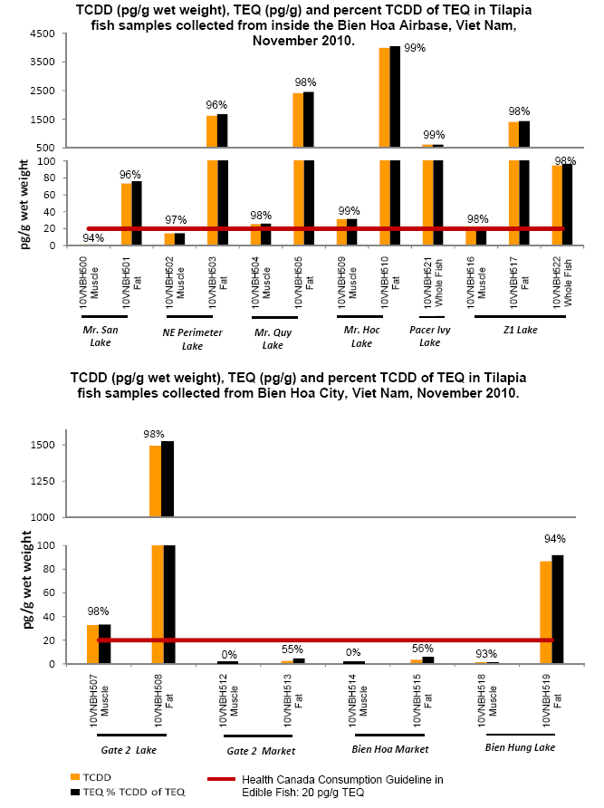

Slide 20
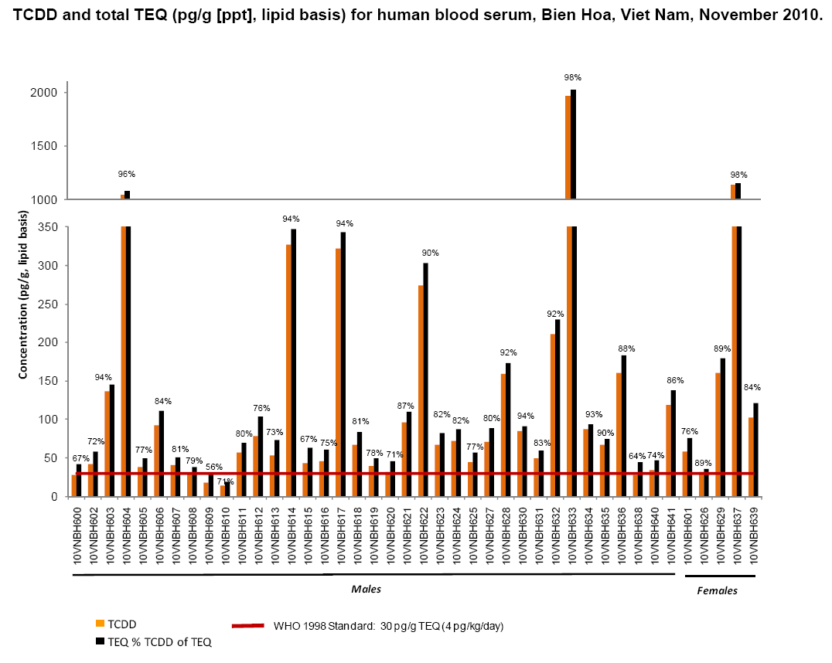

Slide 21
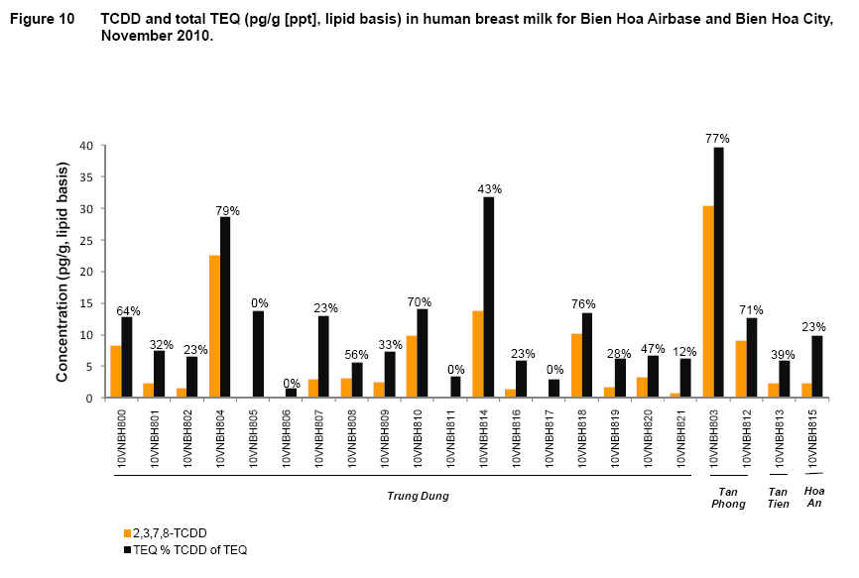

Slide 22
Estimated Mean and Maximum Exposure Dose of 2,3,7,8-TCDD (pg/kg/day), from Consumption of Fish from Bien Hoa
Consumption scenario | Mean pg/kg/day (95 % CIs) | Maximum
Muscle only at 94 g/day | 28 (11, 44) | 44
Muscle only at 170 g/day | 50 (20, 80) | 80
Assuming 95 % muscle, 5 % fat at 94 g/day | 150 (42, 260) | 310
Assuming 95 % muscle, 5 % fat at 170 g/day | 270 (76, 460) | 560
Pacer Ivy whole ﬁsh at 94 g/day | 830 (NA) | NA
Pacer Ivy whole ﬁsh at 170 g/day | 1500 (NA) | NA
Z-1 lake whole ﬁsh 94 g/day | 130 (NA) | NA
Z-1 lake whole ﬁsh 170 g/day | 230 (NA) | NA
Recommended maximum = 4 pg/kg/day
NA = Conﬁdence limits not calculated.

Slide 23
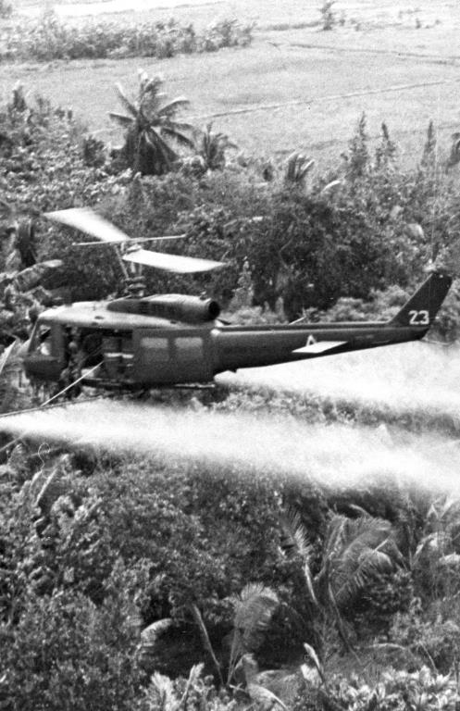
Conclusions
Bien Hoa Airbase is a significant dioxin hotspot.
Elevated levels of dioxins are found on Bien Hoa Airbase, which are above the Vietnamese and international standards.
The source of dioxins was historical use of Agent Orange and other herbicides during Operation Ranch Hand in the US-Viet Nam war.
Ponds at the former US airbase at Bien Hoa are contaminated with Agent Orange.
The ponds had been used for aquaculture, and fish from those ponds have been sold to the public.

Slide 24
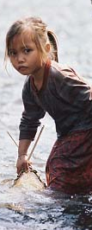
Conclusions (2)
For on-base tilapia, muscle concentrations of 2,3,7,8-TCDD ranged from 1.4 to 32.7 pg/g. Fat concentrations ranged from 73.3 to 3,990 pg/g.
People who eat fish and other aquatic organisms from the Airbase have higher risk of elevated dioxin levels in their bodies.
Estimated human exposure doses exceed international guidelines and exceed 2,3,7,8-TCDD’s lowest adverse effect level criteria.
The Bien Hoa fishponds are a completed human pathway for TCDD exposure.

Slide 25

Recommendations
Clean up of Bien Hoa Airbase is urgently required.
Cultivation and sale of fish from Bien Hoa Airbase should be halted immediately.
Need to protect future generations of Vietnamese from exposure to dioxin and other toxic chemicals.
Continued awareness raising of dioxin exposure pathways (i.e., eating contaminated fish and aquatic animals from the Airbase) is required to protect people from future exposure to dioxins.
Lessons learned from the ongoing clean-up of Da Nang Airport will be invaluable for the future remediation of Bien Hoa Airbase.

Slide 26
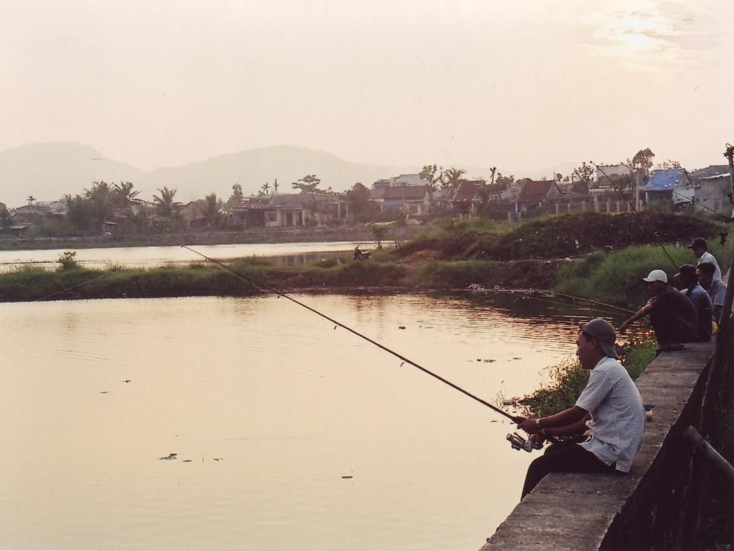
Thank You!
Authors: Boivin TG¹, Sorenson K², Chenevey P², Moats D³, Pohl HR⁴ and Durant J⁴
THANK YOU
Contacts:
¹ Boivin Enterprises Inc., 107D Meyer Rd.,
Salt Spring Island, B.C., Canada.
² CDM Smith International Inc., Denver, COL, USA.
³ Hatfield Consultants Partnership, 200-850 Harbourside Drive, North Vancouver, B.C., Canada.
⁴ Agency for Toxic Substances and Disease Registry, Atlanta, GA, USA.

