Slide 1
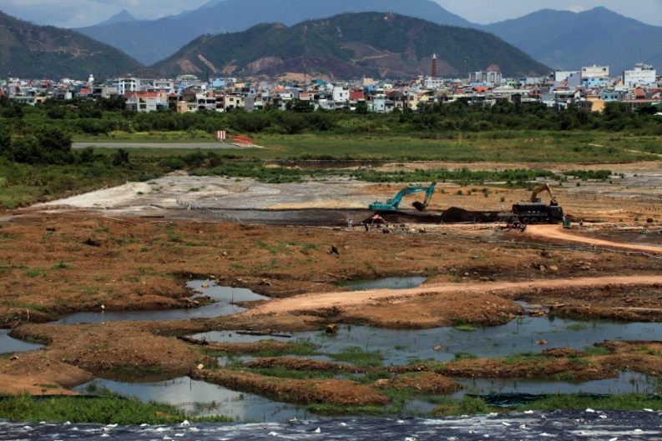
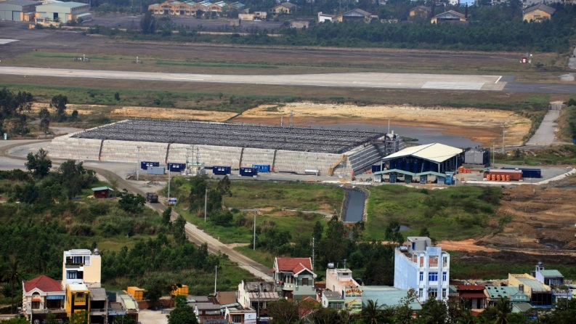
FULL-SCALE THERMAL TREATMENT
OF AGENT ORANGE DIOXINS
AT DANANG AIRPORT, VIETNAM
Kent Sorenson CDM Smith
Jeff Bamer CDM Smith
Alexis Lopez CDM Smith
Pete Chenevey CDM Smith
Randa Chichakli CDM Smith
Ralph Baker TerraTherm*
Gorm Heron TerraTherm
Tom Boivin Hatfield Consultants*
Maura Patterson USAID*
*formerly

Slide 2
Acknowledgements
This work is funded and overseen by USAID. Special thanks to:
  Michael Greene
  Joakim Parker
  Chris Abrams
  Kyung Choe
  Jim Brown
  Maura Patterson
  Andrew Sayers-Fay
  Phuc Nguyen

Slide 3
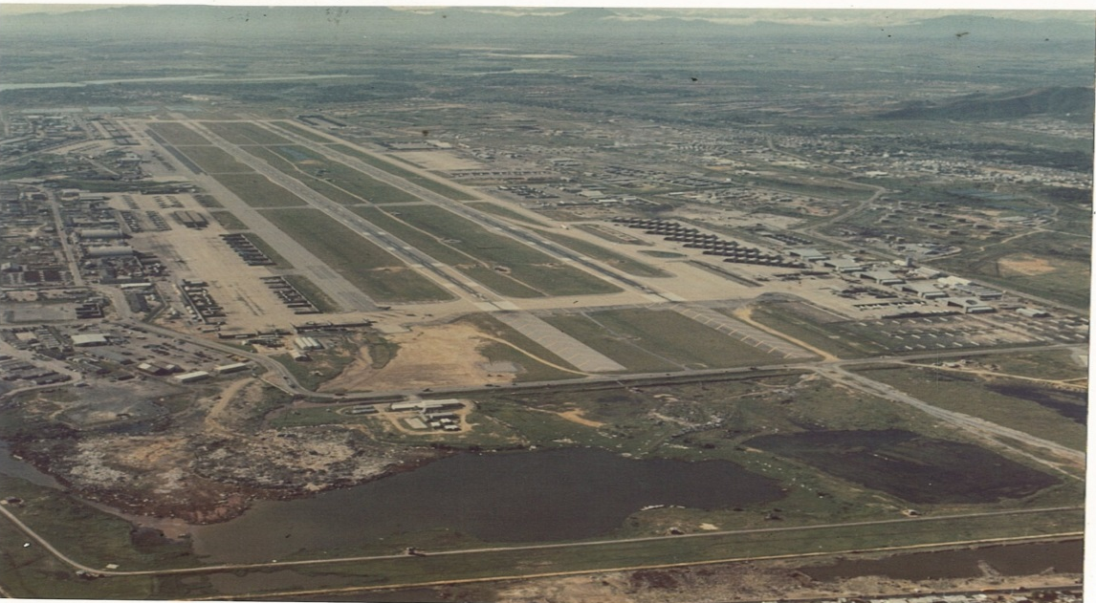
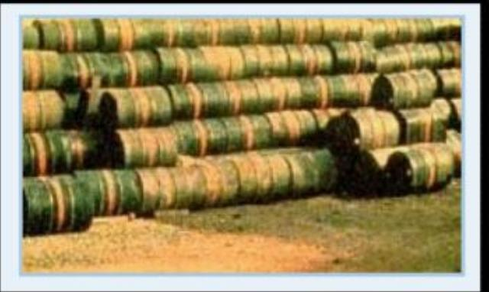
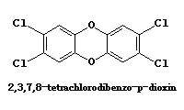
Agent Orange Use at Danang
Operation Ranch Hand – herbicides for defoliation
Agent Orange contained dioxin as 2,3,7,8-TCDD
Over 100,000 barrels used at Danang
USAID lead agency for cleanup at Danang
Danang Airbase - 1972

Slide 4
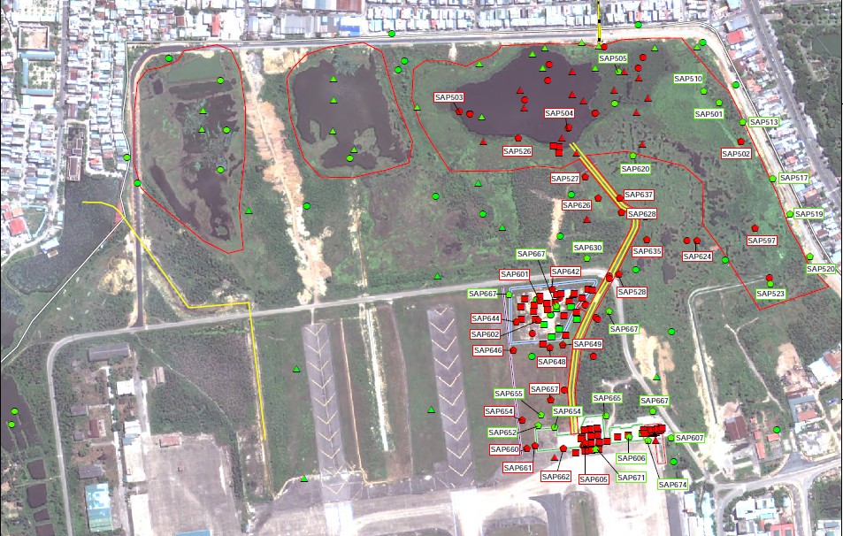
Danang Airport
Discrete soil and sediment samples collected through January 2010
Notes:
Talk about different areas, hot spots, hydrology

Slide 5
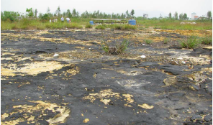
Environmental Assessment (EA) Sampling
Environmental Assessment (EA) Site Characterization Information
  ~89 discrete soil/sediment samples from previous studies
  34 discrete soil samples collected during EA (11 exceeding standard)
  28 discrete sediment samples collected during EA (11 exceeding standard)

Slide 6
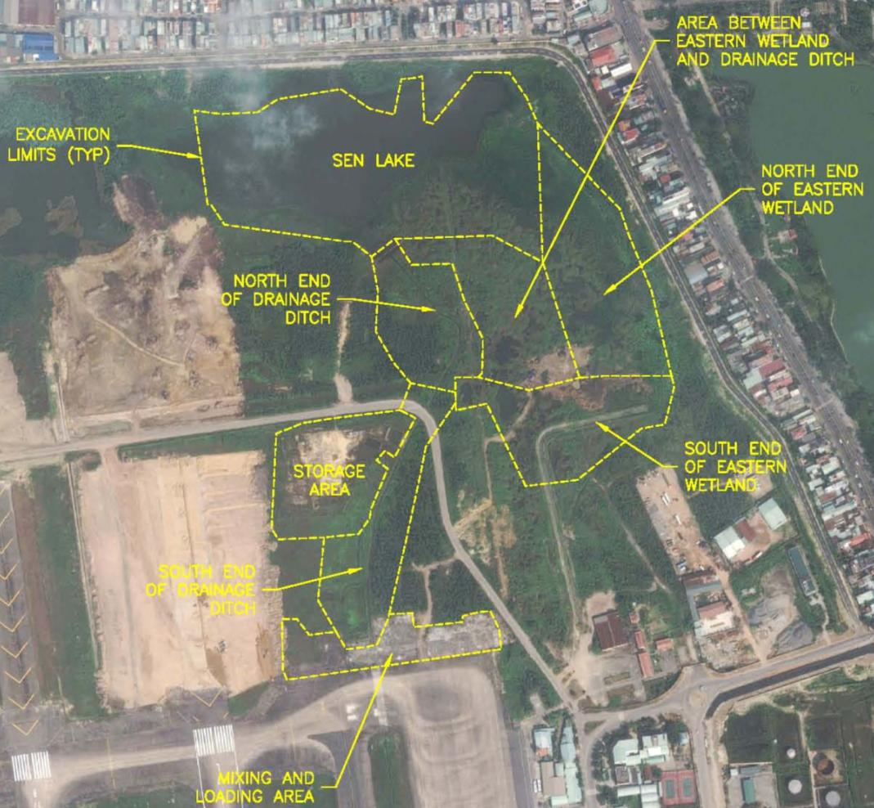
Remedy
Eastern Hot Spot: 1.9 Ha
Design excavation areas
~20 Ha total area
15 cm to > 3 m depth
Sen Lake and Wetland:
11 Ha
Drainage Ditch:
3.4 Ha
Former Storage Area: 1.7 Ha
Mixing and Loading Area: 1.4 Ha

Slide 7
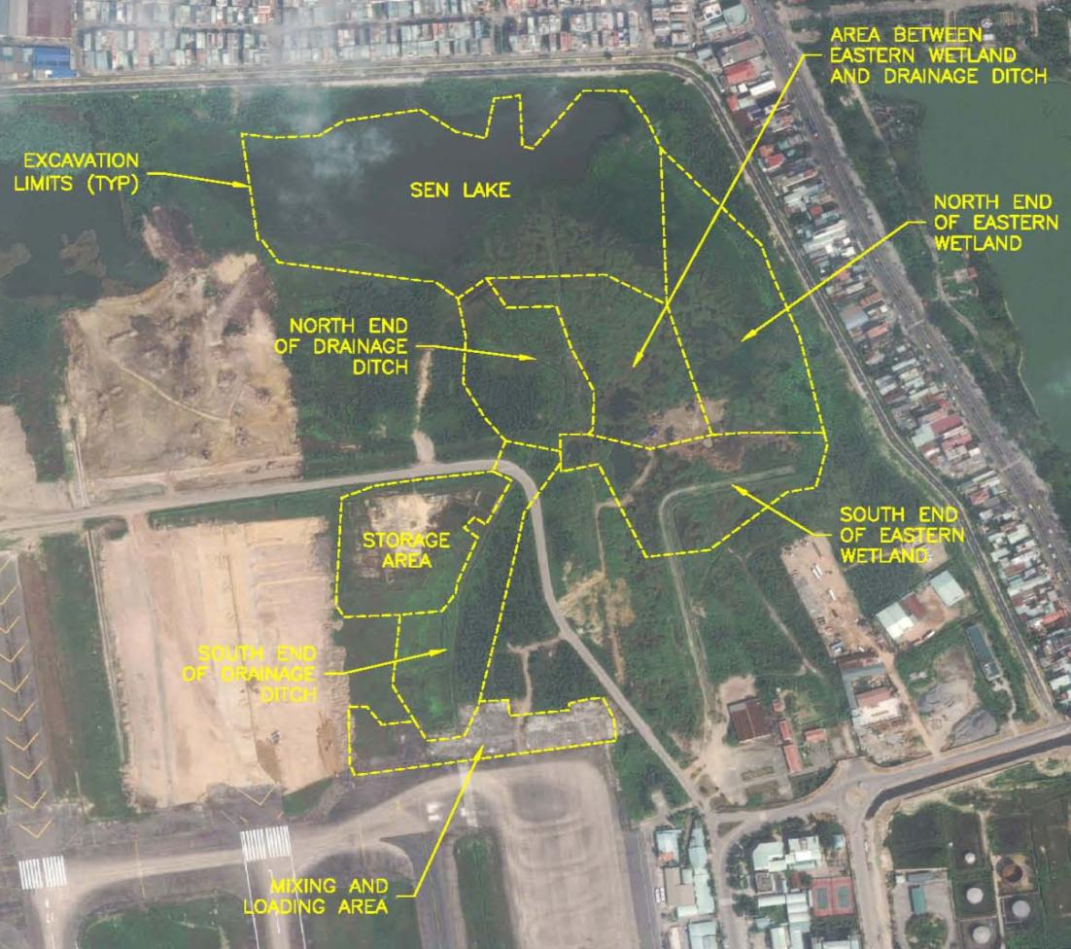
Remedy
Two-phased implementation
“Upland” in Phase 1
Primarily sediments in Phase 2
Phase II
Phase I
IPTD Pile

Slide 8
Environmental Assessment (EA) Remedy Selection
EA evaluated four alternatives:
  No Action
  Passive Landfill
  Active Landfill (Bioremediation)
  In-Pile Thermal Desorption® (IPTD®) - patented by Royal Dutch Shell and further developed by the exclusive licensee, TerraTherm, Inc.

Slide 9
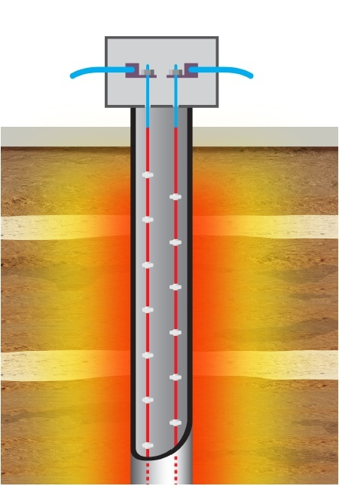
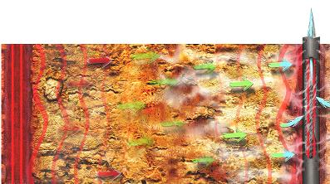
EA Remedy Selection (cont.)
IPTD® selected based on:
  Effectiveness: only alternative proven to destroy dioxin to Vietnam dioxin standards for soil (1,000 ppt) and sediment (150 ppt)
  Implementability: all alternatives implementable at Danang Airport
  Environmental Impact: IPTD® had lowest potential environmental impact
  Cost: IPTD® cost estimate in same range as other alternatives when long term landfill O&M was considered
Destruction depends on both temperature and time
400
t₃
= 335°C
°C
300
200
t₂
100
t₁
Heater
Heater
t_{1,2,3} = temperature progression

Slide 10
IPTD®
Applicability to Dioxins

Slide 11
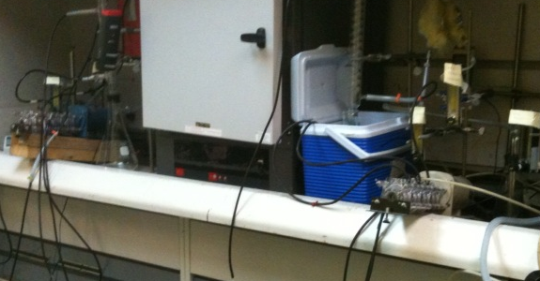
Danang Airport Treatability Testing
Pre-treatment 2,3,7,8-TCDD concentrations
  Soil: 130,000 ppt to 157,000 ppt (VN standard = 1,000 ppt)
  Sediment: 5,970 ppt to 7,480 ppt (VN standard = 150 ppt)
Post-treatment 2,3,7,8-TCDD concentrations
  MLA Soil below soil
  cleanup goal (1,000 ppt)
  after 10 days
  Sen Lake Sediment
  below sediment cleanup
  goal (150 ppt)
  after 7 days

Slide 12
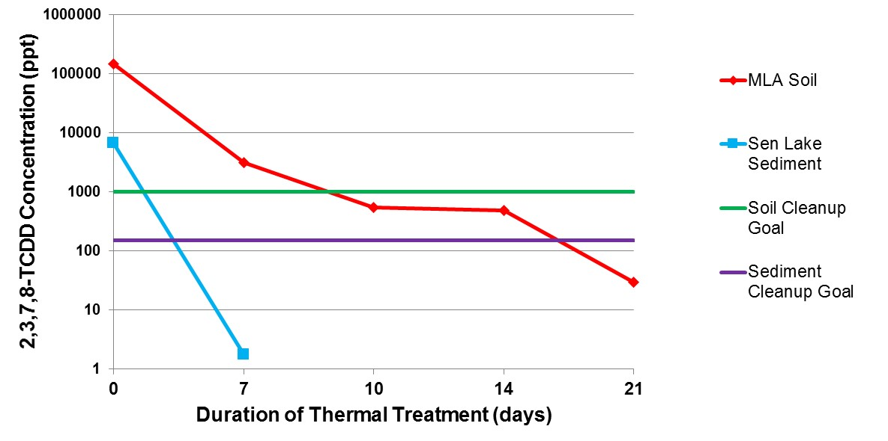
Treatability Testing Results

Slide 13
IPTD® Pile Design
Conceptual design - fully contained and insulated structure
Steel Sheeting
Insulated Surface Cover
Insulated Sidewall Panel
Horizontal Vapor Extraction Well
Pile Structure
Excavated Soil
Drain Piped to Sump
Drainage Layer
Heater-Only Well
Air Inlet Well
Grade Level
Insulated Floor
Note: design evolved after the EA from an above ground stockpile of contaminated soil/sediment surrounded by clean soil berms to an insulated concrete structure

Slide 14
IPTD® Pile Design
Dimensions:
105 m X 70 m X 6 m
Capacity: 45,000 m3
Heater well spacing:
2.7 m (8.9 ft)
# heater wells: 1,254
# temperature monitoring
wells: 56
# pressure monitoring
wells: 8
# air inlet wells: 202

Slide 15
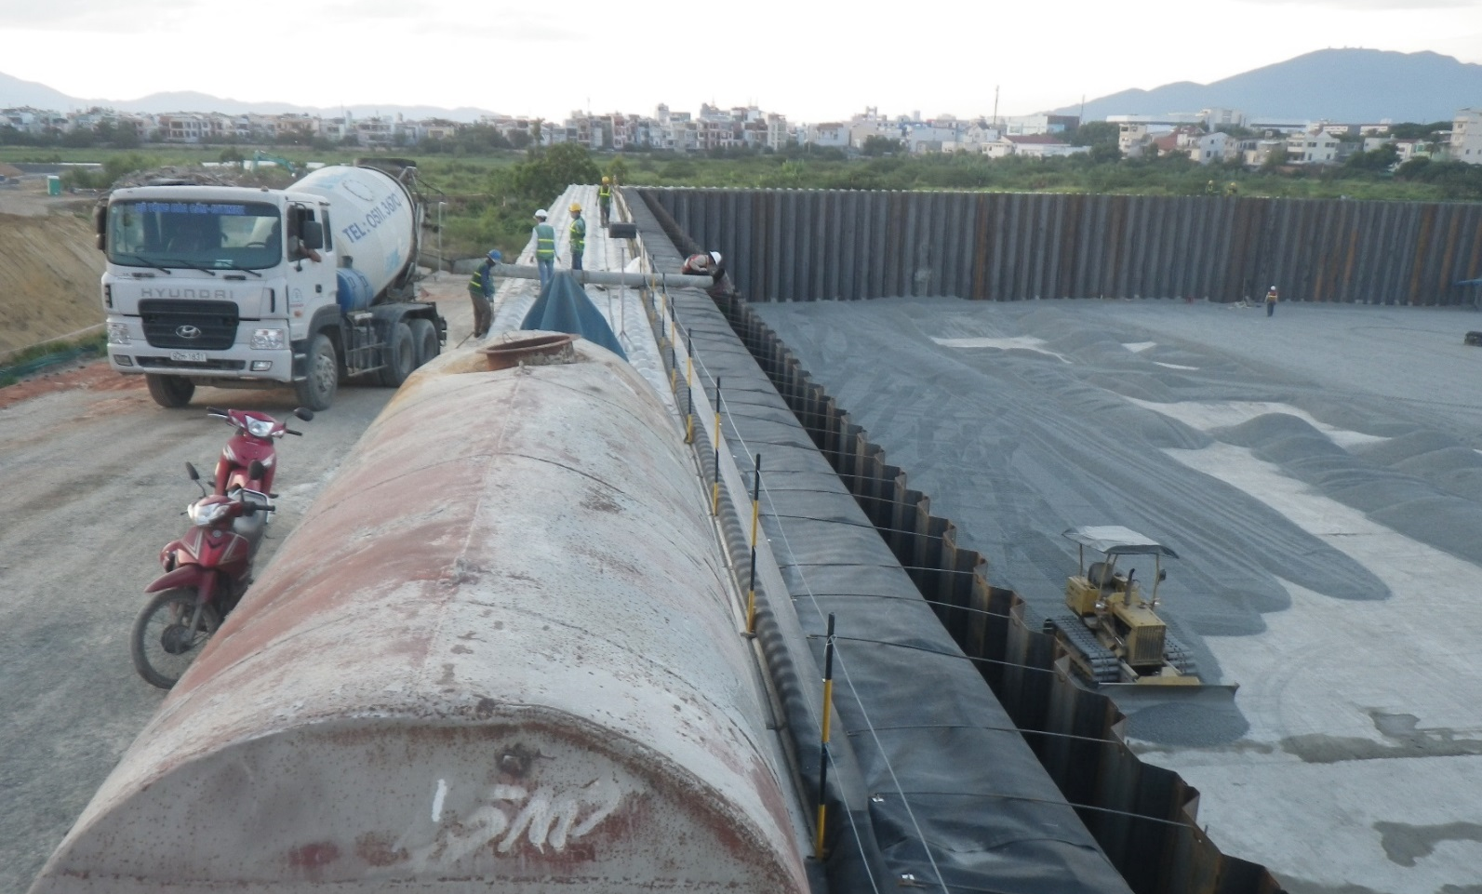
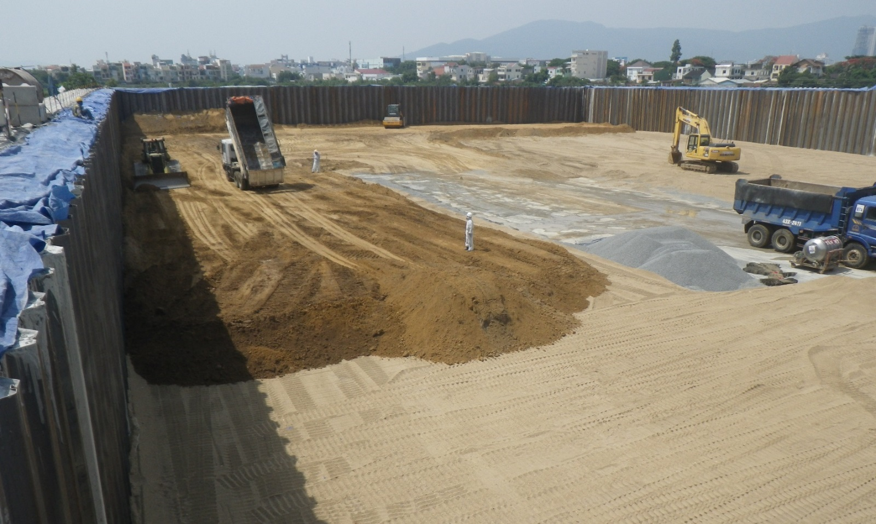
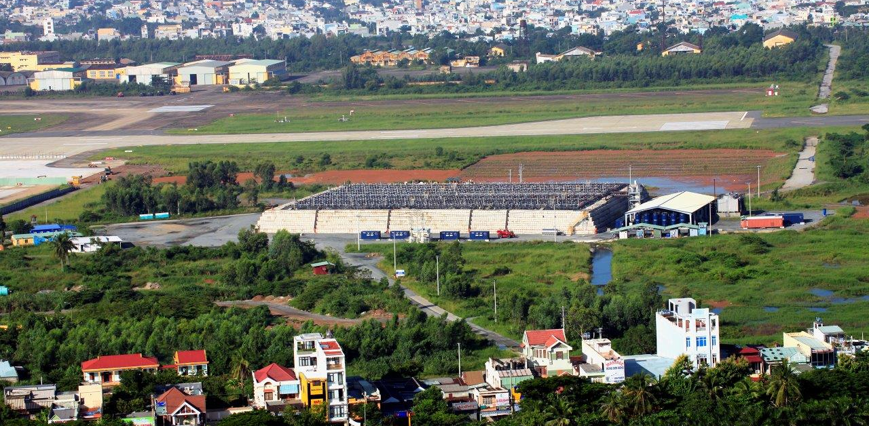
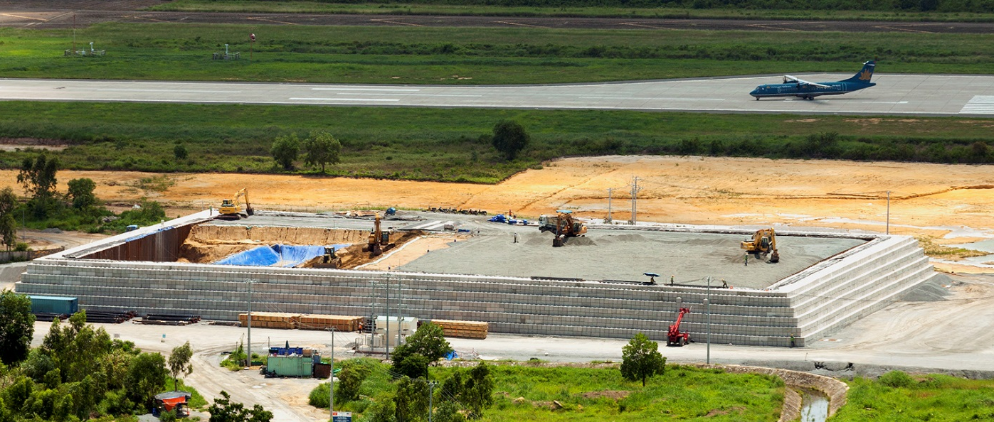
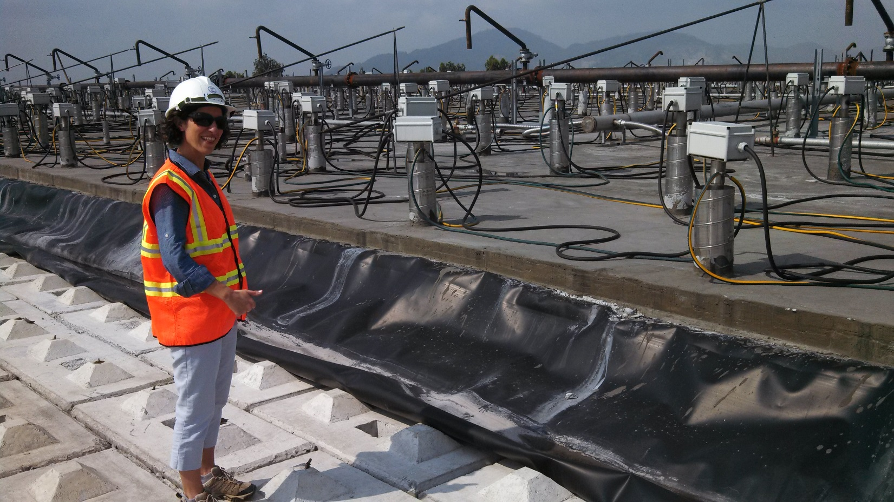

Slide 16

Phase 1 Results – Calculated average pile temperature
Notes:
Shows the calculated average pile structure temperature.
Average pile temperature is representative of all the temperature sensors installed in the soil interval from 30-600 cm.

Slide 17
Phase 1 Results – Average centroid temperature by treatment zone depth interval (10 mo. heating)
Notes:
Shows the average target treatment zone (TTZ) centroid temperature by depth layers. Even though the average target temperature was reached on January 14, 2015, several layers, especially the upper part of the pile, were lagging in temperature, while the mid-depths of the pile were substantially warmer, bringing up the average pile temperature. An average temperature of 335°C (635°F) was not reached in the top 30 cm pile layer until March 25, 2015. At that point all layers from 200 to 500 cm in the pile had reached an average temperature at or above 490°C (914°F).
On March 16, 2015, confirmatory soil sampling was initiated. Based on the results, the heaters were deenergized on April 9, 2015. At that point the highest average temperature was recorded for the 300 cm layer at 577°C (1,070°F).

Slide 18
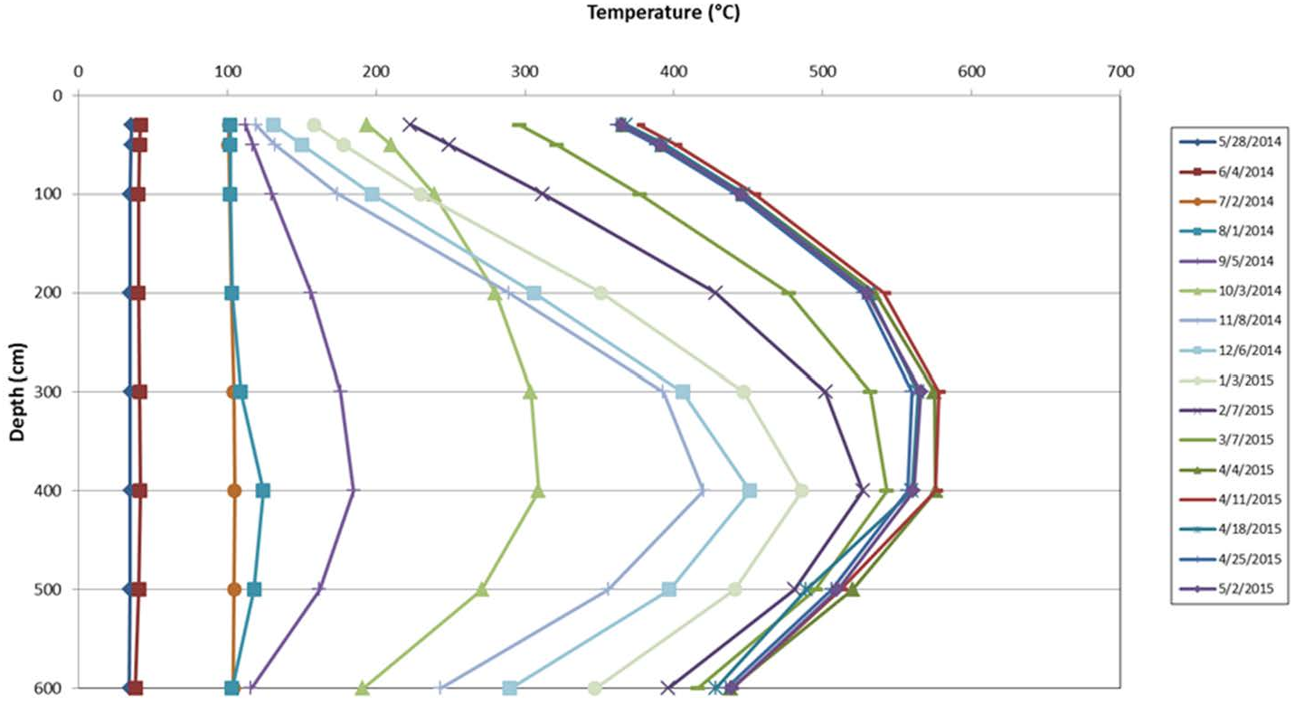
Phase 1 Results – Average soil temperature vs. depth at pile interior
Notes:
Shows the vertical profile by depth of the average temperature of all interior thermocouple locations.
The average temperature at all depths decreased slightly in the latter part of the month of April. As of April 30th, the average interior temperatures throughout the entire depth of the pile ranged between approximately 360C and 550C.

Slide 19
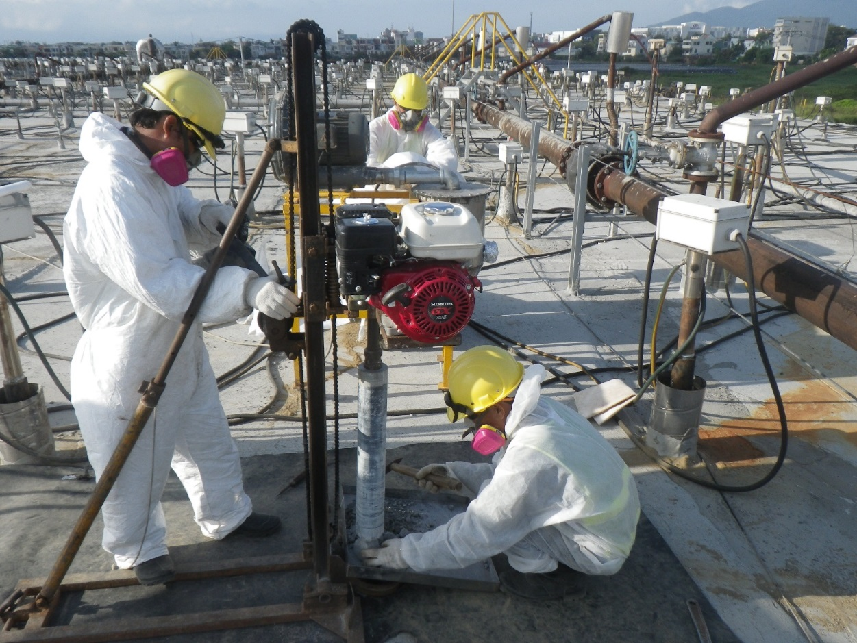
Application of Incremental Sampling Methodology to Treatment Confirmation
Must confirm average concentration < 150 ppt
Pile divided into six, 1-m decision units
vertically (DU layers)
Modified “pot-holing”
used to collect samples
Triplicate collected
for one layer
30 Borings
-0 m
DU-1
-1 m
DU-2
-2 m
Core Increments
DU-3
-3 m
DU-4
-4 m

Slide 20
Phase 1 Final Sample Results (May 2015)
Sample ID | Location | Date Sampled | Action Level (pg TEQ/g) | Dioxin Concentration (pg TEQ/g)
1R-SL-P1-IPTD-0001 | Phase I IPTD samples collected at A locations, 0-1m | 3/23/2015 | 150 | 51.5
1R-SL-P1-IPTD-0002 | Phase I IPTD samples collected at B locations, 1-2m | 4/25/2015 | 150 | 0.332
1R-SL-P1-IPTD-0003 | Phase I IPTD samples collected at B locations, 2-3m | 4/25/2015 | 150 | 0.237, 2.34, 0.27 95% UCL = 2.6
1R-SL-P1-IPTD-0004 | Phase I IPTD samples collected at B locations, 3-4m | 4/25/2015 | 150 | 0.304
1R-SL-P1-IPTD-0005 | Phase I IPTD samples collected at B locations, 4-5m | 4/25/2015 | 150 | 0.0918
1R-SL-P1-IPTD-0006 | Phase I IPTD samples collected at B locations, 5-6m | 4/25/2015 | 150 | 0.981 (lab dup 0.819)
Depth (m)
95% UCL = 2.6 pg/g

Slide 21
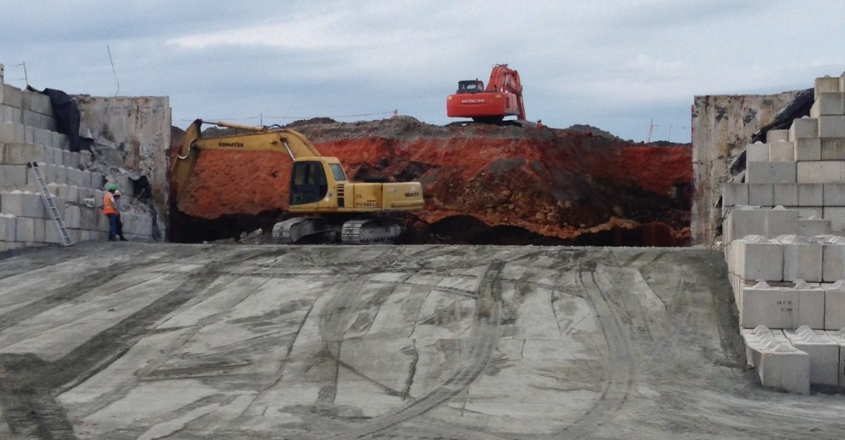
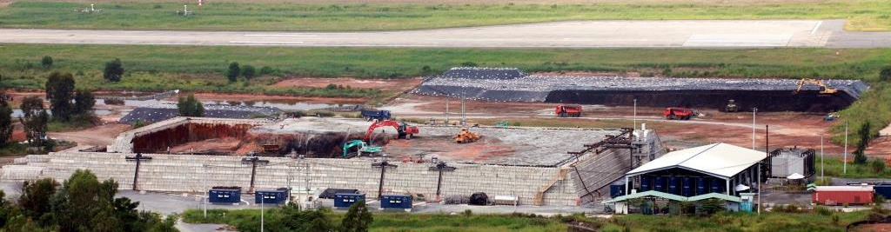
Cooling and Removing Treated Material
Phase 1 pile was quenched May-July 2015
Phase 1 treated soil/ sediment was removed September-October 2015
Temporary storage area for Phase 1 treated material
Removal of Phase 1 treated soil/sediment

Slide 22
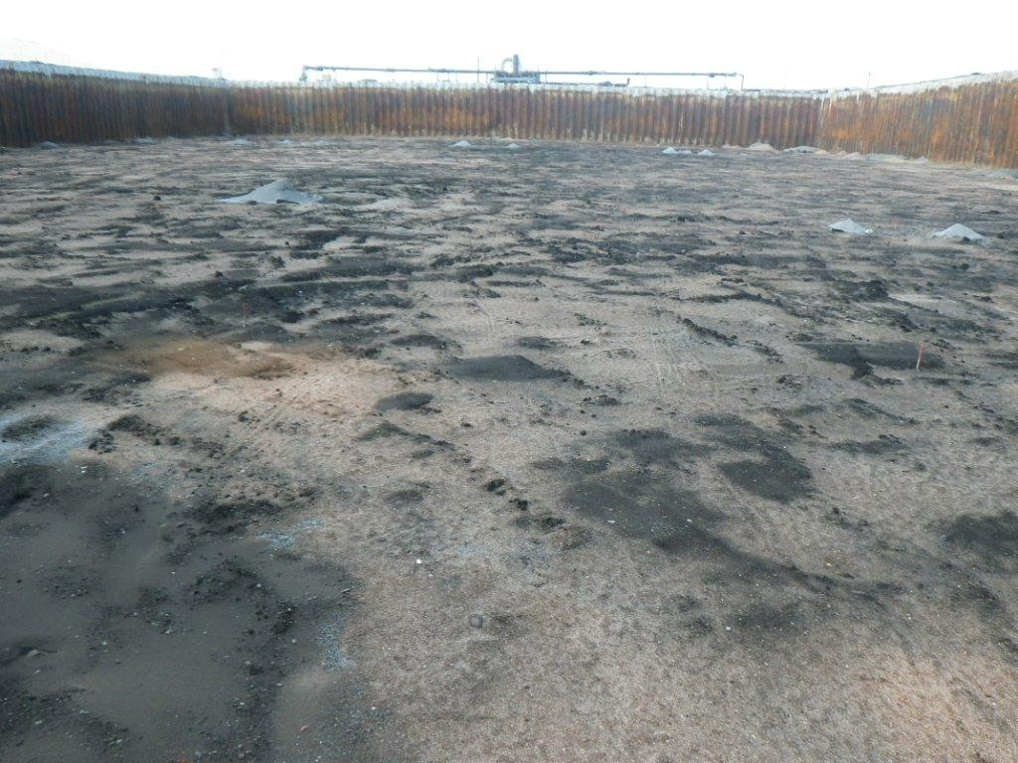
Phase 2 Modifications
Design
  Heaters
  Cover
  Liquid Vapor Treatment Plant (LVTP) Modifications
Mass Balance
  Collect initial ISM samples in pile
  Increased sampling of LVTP processes
Ready for Phase 2!

Slide 23
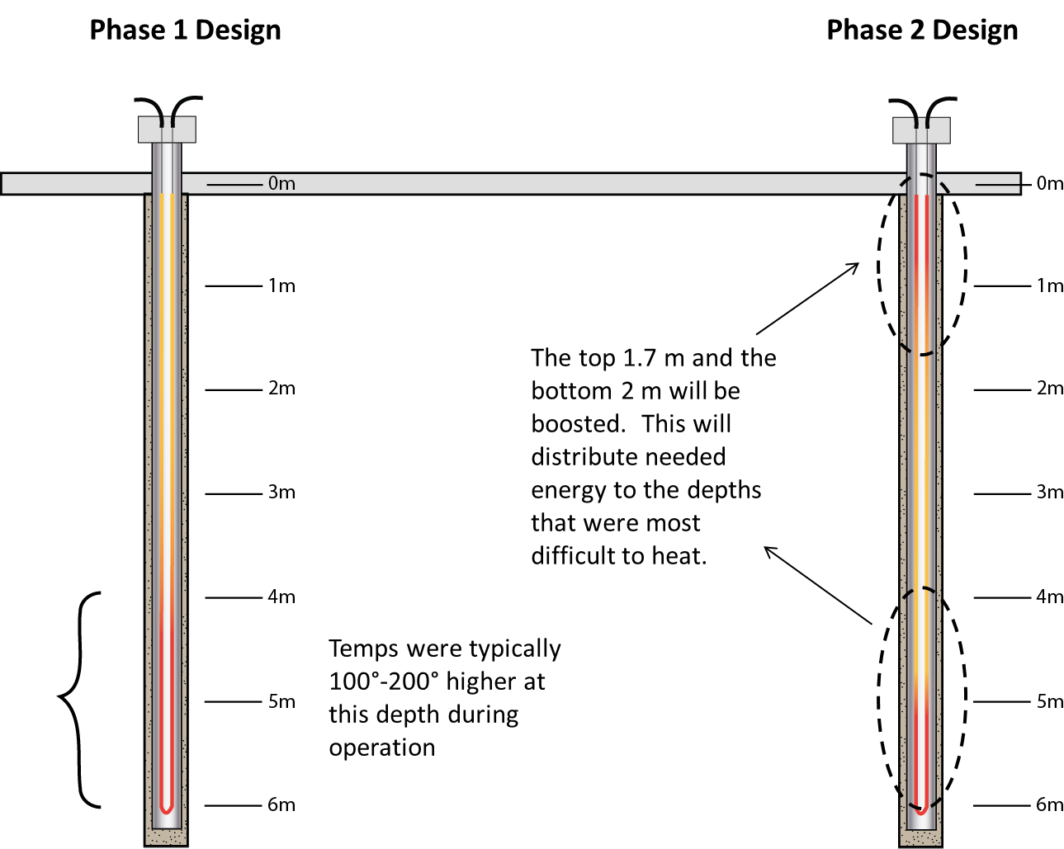
Modified Heater Design
Bottom 2m boost

Slide 24
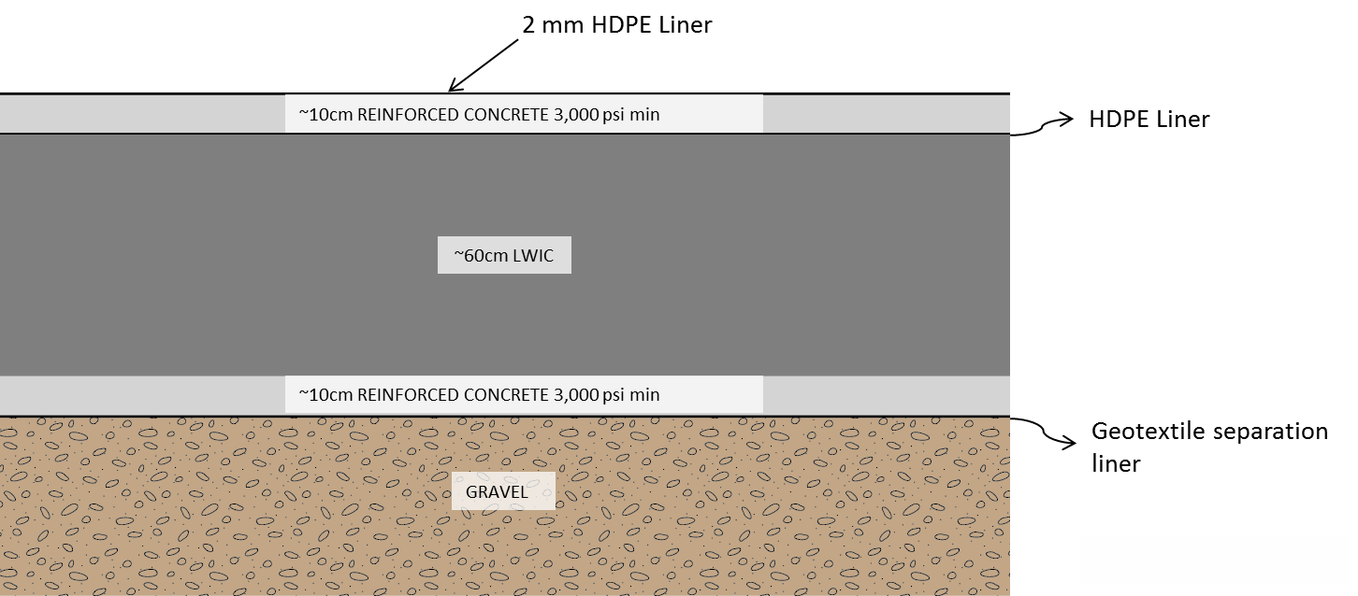
Cover Redesign
210 kg/cm²
210 kg/cm²

Slide 25
Phase 2 Pre-treatment Concentrations by ISM
+/- 275 pg/g
Depth (m)

Slide 26
Phase 2 Results – Average centroid temperature by treatment zone depth interval (6 mo. heating)
Notes:
Shows the average target treatment zone (TTZ) centroid temperature by depth layers. Even though the average target temperature was reached on January 14, 2015, several layers, especially the upper part of the pile, were lagging in temperature, while the mid-depths of the pile were substantially warmer, bringing up the average pile temperature. An average temperature of 335°C (635°F) was not reached in the top 30 cm pile layer until March 25, 2015. At that point all layers from 200 to 500 cm in the pile had reached an average temperature at or above 490°C (914°F).
On March 16, 2015, confirmatory soil sampling was initiated. Based on the results, the heaters were deenergized on April 9, 2015. At that point the highest average temperature was recorded for the 300 cm layer at 577°C (1,070°F).

Slide 27
Phase 2 Results
Notes:
.

Slide 28
Phase 2 Final Sample Results (June 2017)
95% UCL = 0.24 pg/g
Depth (m)
99.99% Removal for all Decision Units

Slide 29
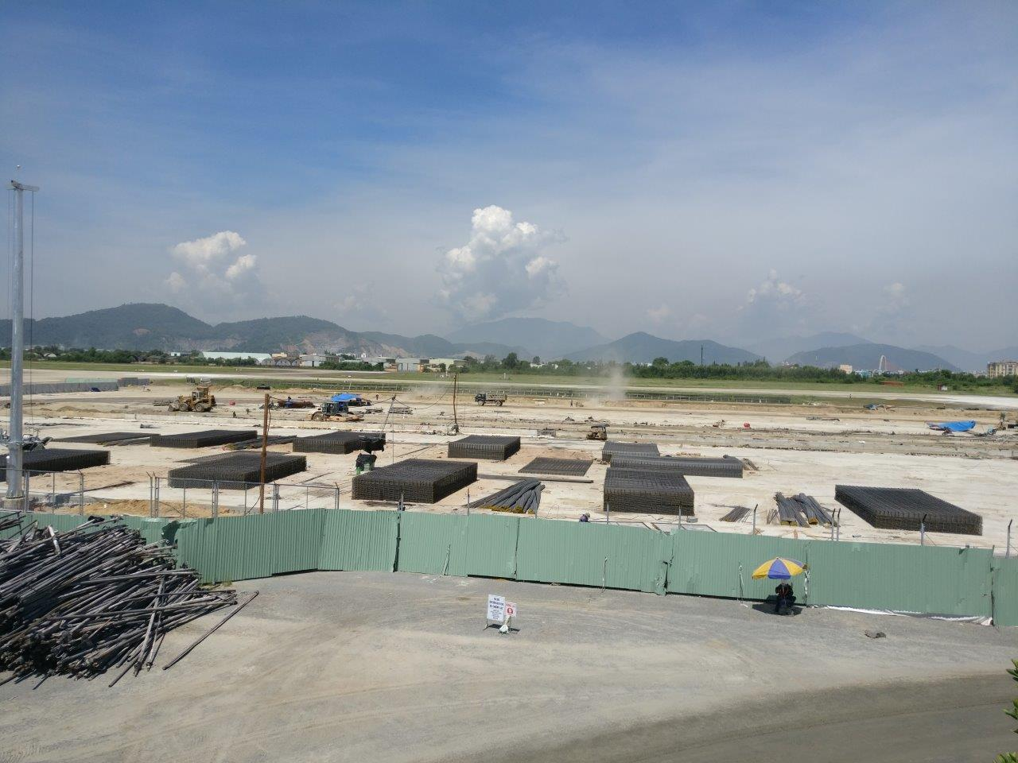
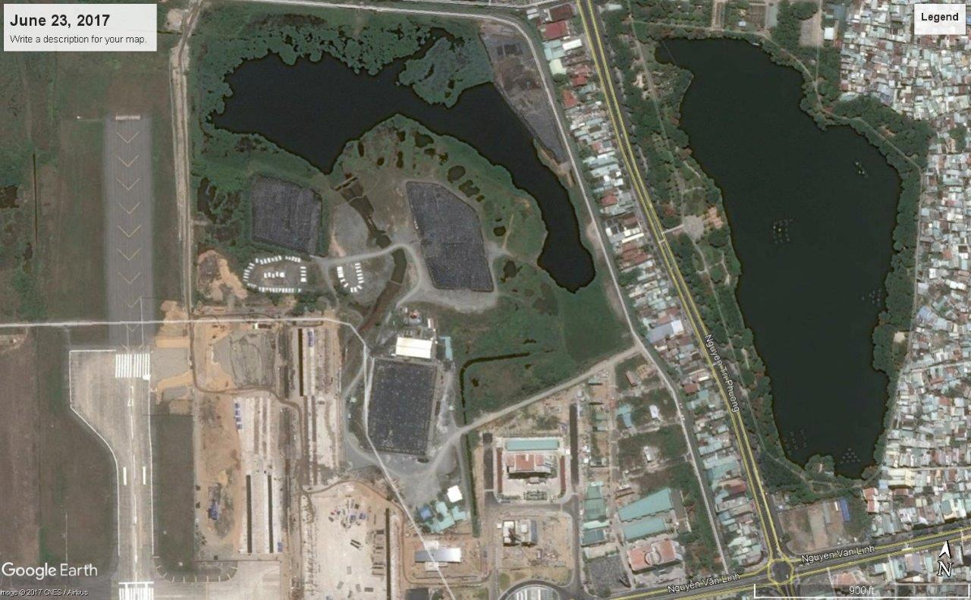
Conclusions
Pre-design investigation through complete site cleanup achieved in less than 9 years
IPTD met stringent treatment standard with >99.99% removal
ISM for confirmation sampling minimized variability
Danang Airport will be ready for transfer in 2018

Slide 30
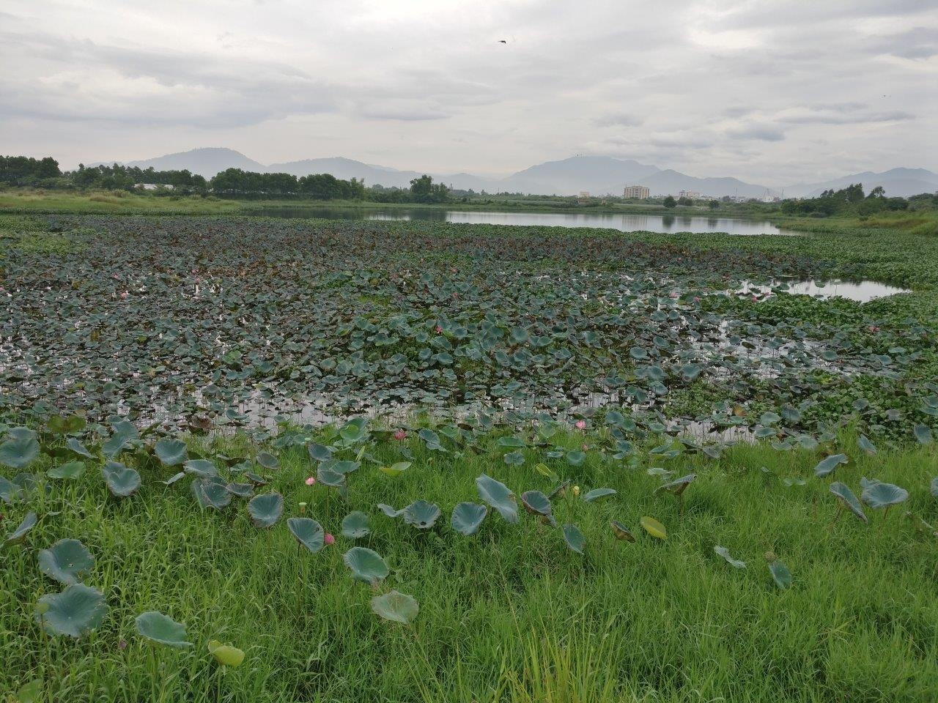
Questions?

