Slide 1
The Aspen Institute drives change through dialogue, leadership, and action to help solve the greatest challenges of our time.
OCTOBER 30, 2020

Slide 2
The Aspen Institute drives change through dialogue, leadership, and action to help solve the greatest challenges of our time.
OCTOBER 30, 2020

Slide 3
Presentation Title here
Subhead to go here

Slide 4
Presentation Title Here
Subhead to go here

Slide 5
Presentation Title Here
Subhead to go here

Slide 6
Headline to go here

Slide 7
The Aspen Institute drives change through dialogue, leadership, and action to help solve the greatest challenges of our time.
OCTOBER 30, 2020

Slide 8
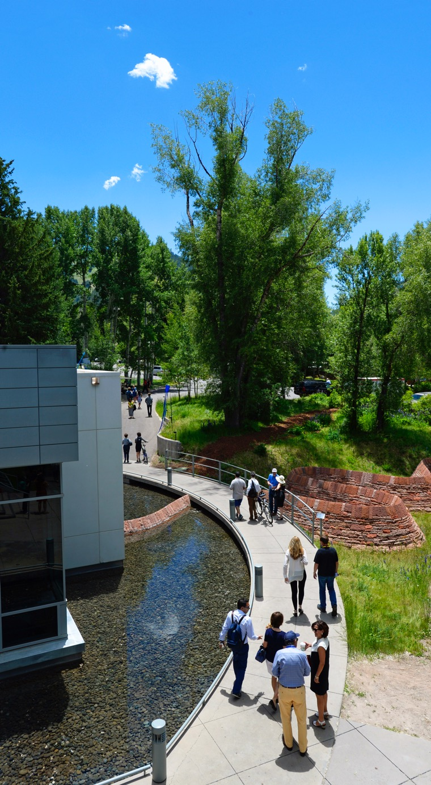
Our Mission
IDEAS
Spark intellectual inquiry and exchange, connecting new concepts to timeless values
LEADERSHIP
Create a diverse worldwide community of leaders committed to the greater good
ACTION
Provide a nonpartisan forum for reaching solutions on vital public policy issues

Slide 9
Areas of Focus
Business & Society
Communication & Culture
Economic Opportunity & Development
Education
Energy & Environment
Health & Sport
Justice & Civic Identity
Philanthropy & Social Enterprise
Security and Global Affairs

Slide 10
Our Mission
IDEAS
Spark intellectual inquiry and exchange, connecting new concepts to timeless values
LEADERSHIP
Create a diverse worldwide community of leaders committed to the greater good
ACTION
Provide a nonpartisan forum for reaching solutions on vital public policy issues

Slide 11

Areas of Focus
Business & Society
Communication & Culture
Economic Opportunity & Development
Education
Energy & Environment
Health & Sport
Justice & Civic Identity
Philanthropy & Social Enterprise
Security and Global Affairs

Slide 12

The Aspen Institute
2300 N St NW | Suite 700 | Washington DC, 20037
www.aspeninstitute.org

Slide 13
#aspeninstitute

