Slide 1

ROAD Session Virtual Exchange
Rebuilding with Care:
Advancing Quality Childcare in Rural Places

Slide 2





Today’s Event Partners
Welcome
Rob Grunewald
Economist, Community Development and Engagement
Federal Reserve Bank of Minneapolis

Slide 3
Why host/organize Rural Opportunity and Development (ROAD) Sessions?
Highlight and unpack rural development ideas and strategies that are critical in response to COVID-19 and to long-term rebuilding and recovery.
Feature stories of on-the-ground practitioners who have experience, wisdom and savvy to share.
Reflect and emphasize the full diversity of rural America – lifting voices and lived experiences from a wide range of rural communities and economies.
Spotlight rural America’s assets and challenges
Infuse practitioner stories and lessons into rural narratives, policymaking and practice across the country
Strengthen the networking of organizations serving rural communities and regions.

Slide 4
Rebuilding with Care Exchange Format
Panel Discussion: 2:00 – 3:15 p.m. ET Our speakers share their understanding of and experience with expanding child care in rural places.
Breakout Rooms: 3:15 – 3:45 p.m. ET Optional Join a breakout to meet others, ask questions, seek advice and share your thinking and experience. Format: Open questions and answers, ideas and advice sharing. Each breakout will include one of today’s speakers plus a facilitator.

Slide 5
Rebuilding with Care Exchange Format
Use the Chat Box to share insights or to echo/underline a panelist’s point.
Please share your thoughts with civility and compassion.
Use the Q & A Box to ask your question of the speakers.
Participant questions will be addressed in the last 15 minutes of the panel discussion, and during the 30-minute follow-on breakout session.

Slide 6
And last before we start…A little Housekeeping
Your mics are muted. If you have any tech issues, please use the Chat box. We have people standing by to address!
At 3:15 ET, enter the breakout discussion by clicking on the link provided in the Chat Box and in the email sent to you today.
You have received an email with a special Zoom link for the breakout session already.
We will send those links again in the next hour to every registered participant’s email.
If you have not received it – please send a note to csg.program@aspeninstitute.org.
Recordings of the first hour will be available on the Aspen CSG event webpage in the next few days. That video link will be sent to all registered.

Slide 7

Welcome Today’s Moderator:
Samantha Evans
Community Development Advisor
Federal Reserve Bank of St. Louis

Slide 8
Rebuilding with Care: Advancing Quality Childcare in Rural Places
Sam Evans Community Development Advisor
May 26, 2021

Slide 9
These comments do not necessarily represent the views of the
Federal Reserve Bank of St. Louis
or the Federal Reserve System.

Slide 10
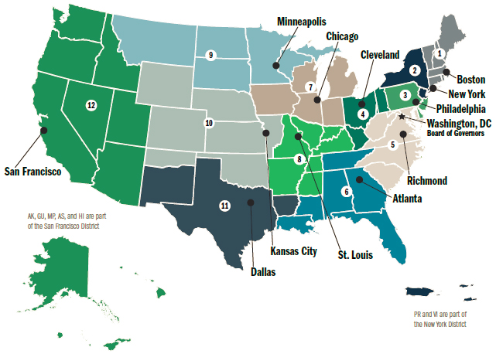

The Federal Reserve is the central bank of the United States. It is responsible for monetary policy, supervision and regulation of banks, and payment systems.
Its community development function aims to promote economic resilience and
mobility for low- and
moderate-income and underserved individuals
and communities.

Slide 11
Child Care Supports the Future and Current Workforce
Influences child development, school readiness, and adult outcomes
Has a substantial impact on workforce participation, job stability, and wages
Affects businesses through workforce supply, productivity, and turnover

Slide 12
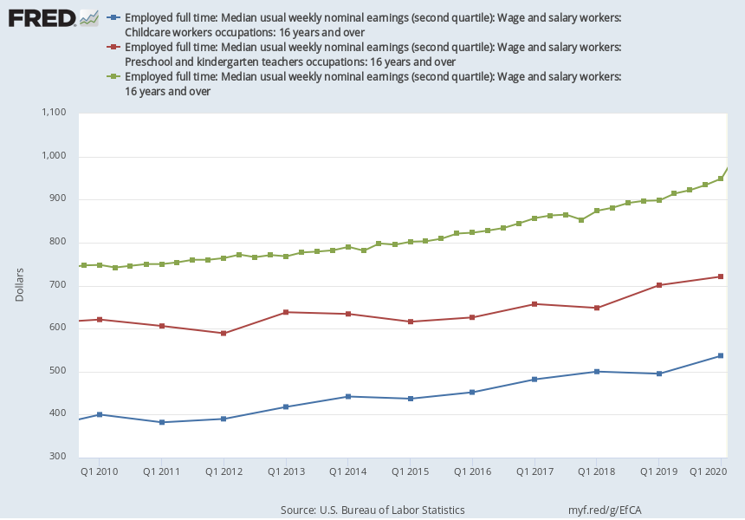
Child Care Workforce Wage Gaps
Source: U.S. Bureau of Labor Statistics
Notes:
Source: U.S. Bureau of Labor Statistics Release: Weekly and Hourly Earnings from the Current Population Survey Units: Dollars, Not Seasonally Adjusted Frequency: Annual Data measure usual weekly earnings of wage and salary workers. Wage and salary workers are workers who receive wages, salaries, commissions, tips, payment in kind, or piece rates. The group includes employees in both the private and public sectors but, for the purposes of the earnings series, it excludes all self-employed persons, both those with incorporated businesses and those with unincorporated businesses.Usual weekly earnings represent earnings before taxes and other deductions and include any overtime pay, commissions, or tips usually received (at the main job in the case of multiple jobholders). Prior to 1994, respondents were asked how much they usually earned per week. Since January 1994, respondents have been asked to identify the easiest way for them to report earnings (hourly, weekly, biweekly, twice monthly, monthly, annually, or other) and how much they usually earn in the reported time period. Earnings reported on a basis other than weekly are converted to a weekly equivalent. The term "usual" is determined by each respondent's own understanding of the term. If the respondent asks for a definition of "usual," interviewers are instructed to define the term as more than half the weeks worked during the past 4 or 5 months. For more information see https://www.bls.gov/cps/earnings.htmThe series comes from the 'Current Population Survey (Household Survey)'The source code is: LEU0254549700 U.S. Bureau of Labor Statistics, Employed full time: Median usual weekly nominal earnings (second quartile): Wage and salary workers: Childcare workers occupations: 16 years and over [LEU0254549700A], retrieved from FRED, Federal Reserve Bank of St. Louis; https://fred.stlouisfed.org/series/LEU0254549700A, May 25, 2021. Source: U.S. Bureau of Labor Statistics Release: Weekly and Hourly Earnings from the Current Population Survey Units: Dollars, Not Seasonally Adjusted Frequency: Annual Data measure usual weekly earnings of wage and salary workers. Wage and salary workers are workers who receive wages, salaries, commissions, tips, payment in kind, or piece rates. The group includes employees in both the private and public sectors but, for the purposes of the earnings series, it excludes all self-employed persons, both those with incorporated businesses and those with unincorporated businesses.Usual weekly earnings represent earnings before taxes and other deductions and include any overtime pay, commissions, or tips usually received (at the main job in the case of multiple jobholders). Prior to 1994, respondents were asked how much they usually earned per week. Since January 1994, respondents have been asked to identify the easiest way for them to report earnings (hourly, weekly, biweekly, twice monthly, monthly, annually, or other) and how much they usually earn in the reported time period. Earnings reported on a basis other than weekly are converted to a weekly equivalent. The term "usual" is determined by each respondent's own understanding of the term. If the respondent asks for a definition of "usual," interviewers are instructed to define the term as more than half the weeks worked during the past 4 or 5 months. For more information see https://www.bls.gov/cps/earnings.htmThe series comes from the 'Current Population Survey (Household Survey)'The source code is: LEU0254537400 U.S. Bureau of Labor Statistics, Employed full time: Median usual weekly nominal earnings (second quartile): Wage and salary workers: Preschool and kindergarten teachers occupations: 16 years and over [LEU0254537400A], retrieved from FRED, Federal Reserve Bank of St. Louis; https://fred.stlouisfed.org/series/LEU0254537400A, May 25, 2021. Source: U.S. Bureau of Labor Statistics Release: Weekly and Hourly Earnings from the Current Population Survey Units: Dollars, Seasonally Adjusted Frequency: Quarterly Data measure usual weekly earnings of wage and salary workers. Wage and salary workers are workers who receive wages, salaries, commissions, tips, payment in kind, or piece rates. The group includes employees in both the private and public sectors but, for the purposes of the earnings series, it excludes all self-employed persons, both those with incorporated businesses and those with unincorporated businesses.Usual weekly earnings represent earnings before taxes and other deductions and include any overtime pay, commissions, or tips usually received (at the main job in the case of multiple jobholders). Prior to 1994, respondents were asked how much they usually earned per week. Since January 1994, respondents have been asked to identify the easiest way for them to report earnings (hourly, weekly, biweekly, twice monthly, monthly, annually, or other) and how much they usually earn in the reported time period. Earnings reported on a basis other than weekly are converted to a weekly equivalent. The term "usual" is determined by each respondent's own understanding of the term. If the respondent asks for a definition of "usual," interviewers are instructed to define the term as more than half the weeks worked during the past 4 or 5 months. For more information see https://www.bls.gov/cps/earnings.htmThe series comes from the 'Current Population Survey (Household Survey)'The source code is: LES1252881500 U.S. Bureau of Labor Statistics, Employed full time: Median usual weekly nominal earnings (second quartile): Wage and salary workers: 16 years and over [LES1252881500Q], retrieved from FRED, Federal Reserve Bank of St. Louis; https://fred.stlouisfed.org/series/LES1252881500Q, May 25, 2021.

Slide 13

The Impact of COVID-19 on Child Care
An estimated 2.6 million of the nation’s health care workers and first responders are parents to children under 14 years old.
COVID-19-related child care closures concentrated in low- and middle-income neighborhoods and could exacerbate pre-pandemic child care supply issues in rural areas

Slide 14
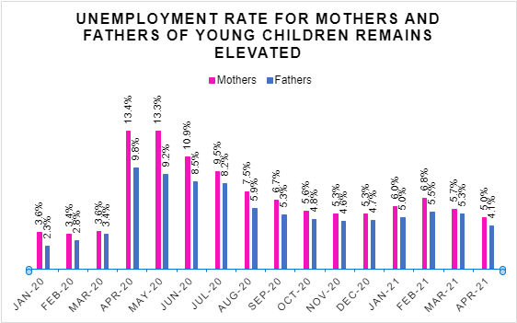
Note: Ana Kent's calculations using IPUMS Current Population Survey. Data are not seasonally adjusted. Mothers and fathers ages 25-54 residing with their children under age 5.

Slide 15
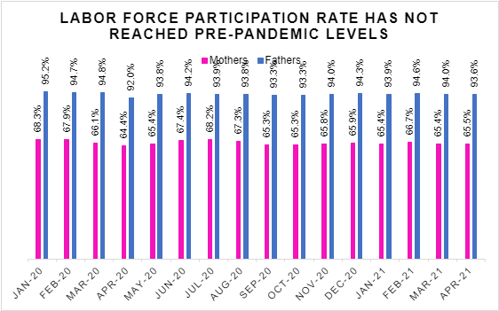
Note: Ana Kent's calculations using IPUMS Current Population Survey. Data are not seasonally adjusted. Mothers and fathers ages 25-54 residing with their children under age 5.

Slide 16
Child Care in Rural Areas
Families rely more on home-based family child care than child care centers
More likely to live in a child care desert and have less access to care during non-traditional hours
Providers face constraints in accessing capital, technical assistance, and quality supports

Slide 17
Rural families use home-based family child care more often than urban families
Percent of children with employed mothers in each primary child care arrangement, 2016
Source: Leila Schochet, 5 Facts To Know About Child Care in Rural America, Center for American Progress, June 4, 2019

Slide 18
Key Takeaways
Child care supports the future and current workforce
Child care business model faces several challenges, including thin profit margins and low wages
Rural families more likely to use family child care and live in a childcare desert
Not all rural communities are the same, and solutions will reflect industries, geographies, and racial and ethnic composition

Slide 19

Child Care in Rural Wisconsin
Corrine Hendrickson
Owner/Operator
Corrine’s Little Explorers Care Center

Slide 20

Child Care on Tribal Lands
Barb Fabre
CEO
Indigenous Visioning

Slide 21

Child Care in Southwest Virginia
Travis Staton
CEO
United Way of Southwest Virginia

Slide 22

Child Care in Vermont
Aly Richards
CEO
Let’s Grow Kids

Slide 23
Join us for the breakout room discussion
To enter the breakout session: Simply use the Zoom breakout link provided in the Chat Box.
We sent every registered email that link again during this hour.
If you did not receive it – please send a note to csg.program@aspeninstitute.org
Each room will include one of our speakers and a facilitator – it may take a few minutes to get them sorted into the right room. Chat until they get there!
Open discussion!

Slide 24
Today’s Event Partners
See you in the Breakout Room!

